Slide 1
Effectiveness of Wax as an Anticorrosion Material
Frank Rampton
Trenton Corporation

Slide 2
Wax as an Anticorrision Coating
Types of Waxes
Characteristics & Effectiveness as a Coating Material
Applications
Tapes
Casing Filling
Hot-Applied Wax

Slide 3
What are the Characteristics of Wax?
Fun handouts are designed to make serious points
Malleable
Depending on temperature and composition
A solid at room temperature, but has a relatively low melting point
Does not crack as the pipe flexes
Seals with itself very well (not just adhere, actually seals)
Displaces moisture (chews forever)
If it can hold moisture, it can keep it from the pipe surface
Protects against the atmosphere
Used to protect food
Non-biodegradable
Non-toxic
Very user friendly

Slide 4
But Wax Does Not Look “Tough”
How can a material that is relatively soft and has a relatively low melting point make a good anticorrosion material?
Permeates the surface of the metal
When struck, it deforms and presses even more into the metal
“You can’t even sandblast wax off the surface.”

Slide 5
The Five Major Types of Waxes
Wax Types
Vegetable
1.75%
Animal
0.75%
Mineral
0.25%
Petroleum
97%
Synthetic
0.25%

Slide 6
Vegetable Wax
Makes up 1.75% of the total use.
Include carnauba & palm
Applications: chewing gum, polishes, inks & leathers

Slide 7
Animal Wax
Makes up 0.75% of the wax usage
Includes beeswax, shellac
Applications: candles, polishes, cosmetics

Slide 8
Synthetic Wax
Makes up 0.25% of the market
Applications: polishes, inks and coatings

Slide 9
Mineral Wax
Mineral wax (ozocerite) is the byproduct of ground petroleum (from sandstone) and coal
A brown to black wax sometimes found in sandstone and used to make candles, polishes, etc.

Slide 10
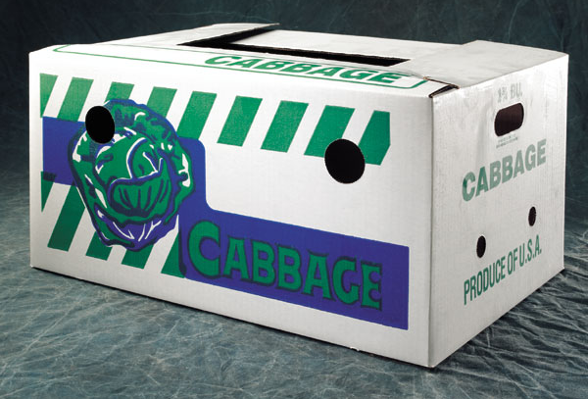
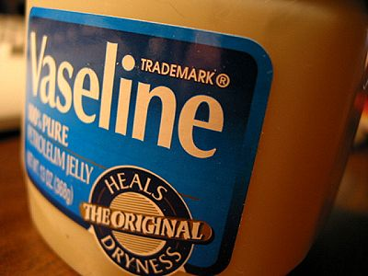
Petroleum Wax
Produced by de-oiling certain fractions from the petroleum refining process (97% of all waxes)
Almost ½ of this type is utilized in paper & packaging applications

Slide 11
Three Types of Petroleum Wax
Petroleum Wax
97%
Microcrystalline
Wax
Paraffin
Petrolatum Wax
They can be blended
The wax of choice is based partially on results desired
Most pipe coatings use either petrolatum or microcrystalline wax (micro wax)

Slide 12
The Three Petroleum Waxes
Paraffin Wax
More brittle
Petrolatum Wax
Between paraffin and microcrystalline in characteristics
Microcrystalline Wax (Micro Wax)
Name is due to a finer crystalline structure
Softer yet tougher, does not crack or flake
More malleable and flexible
Higher melting point
More adhesive, sticks to the surface better
Finer crystal structure better binds to solvents or oils and thus prevents the sweating-out of compositions

Slide 13
Why Micro Wax is a Good Coating
Long history of use: It has been used as an anticorrosive material for over 50 years.
Extremely low moisture absorption and transmission rates: Waxes are solidified oils, and like oil they do not absorb or transmit moisture.
Superior surface wetting: It “wets” the surface, like grease or oil, and will not be displaced by moisture
Permanent flexibility: Micro wax does not become brittle or lose its plasticity and flexibility. It will not flake off or crack after being applied, and it accommodates pipe expansion, contraction and flexing.

Slide 14
Why Micro Wax is a Good Coating (cont.)
Superior adhesion: Micro wax permeates the granular structure of the steel, so it withstands soil stress and separates moisture from the pipe surface.
Resilience under impact: Though micro wax will deform under impact, it will not break, crack or “powder,” and usually a thin film of tightly bonded, very corrosion-resistant material will continue to protect the pipe.
Totally inert: Micro wax does not degrade, so it is extraordinarily long lasting.
Relatively inexpensive: Especially when total application costs are considered.

Slide 15
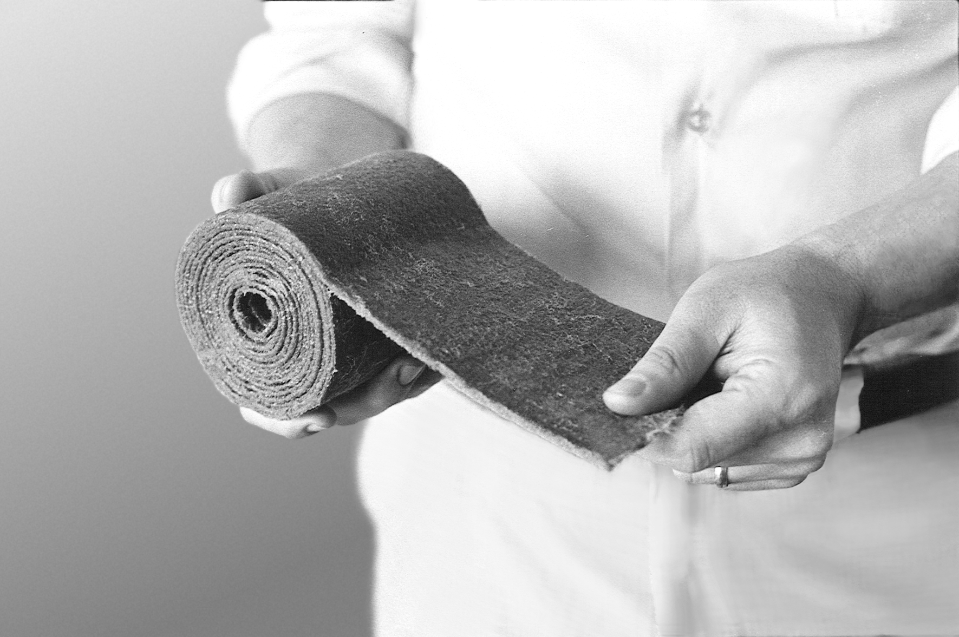
Petrolatum and Micro Wax-Based Tapes
Petrolatum and micro wax-based tapes are used in aboveground and belowground applications.

Slide 16
Conforms to Irregular-Shaped Fittings
Tape is molded into place to conform to the shape of the surface being wrapped.

Slide 17
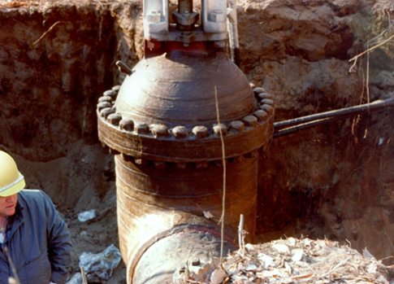
Belowground Fittings
Wax-based tapes are excellent protection for irregular-shaped valves.

Slide 18
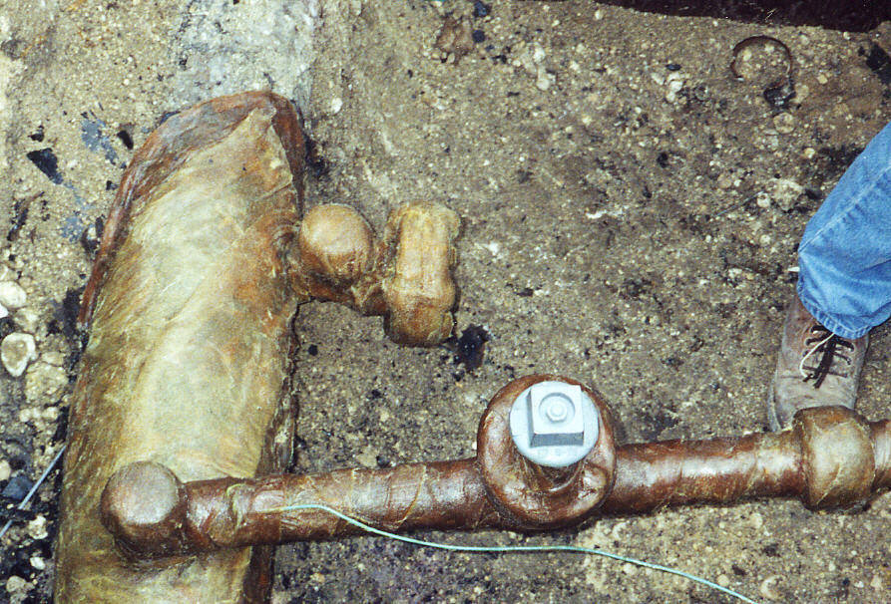
Belowground Fittings

Slide 19
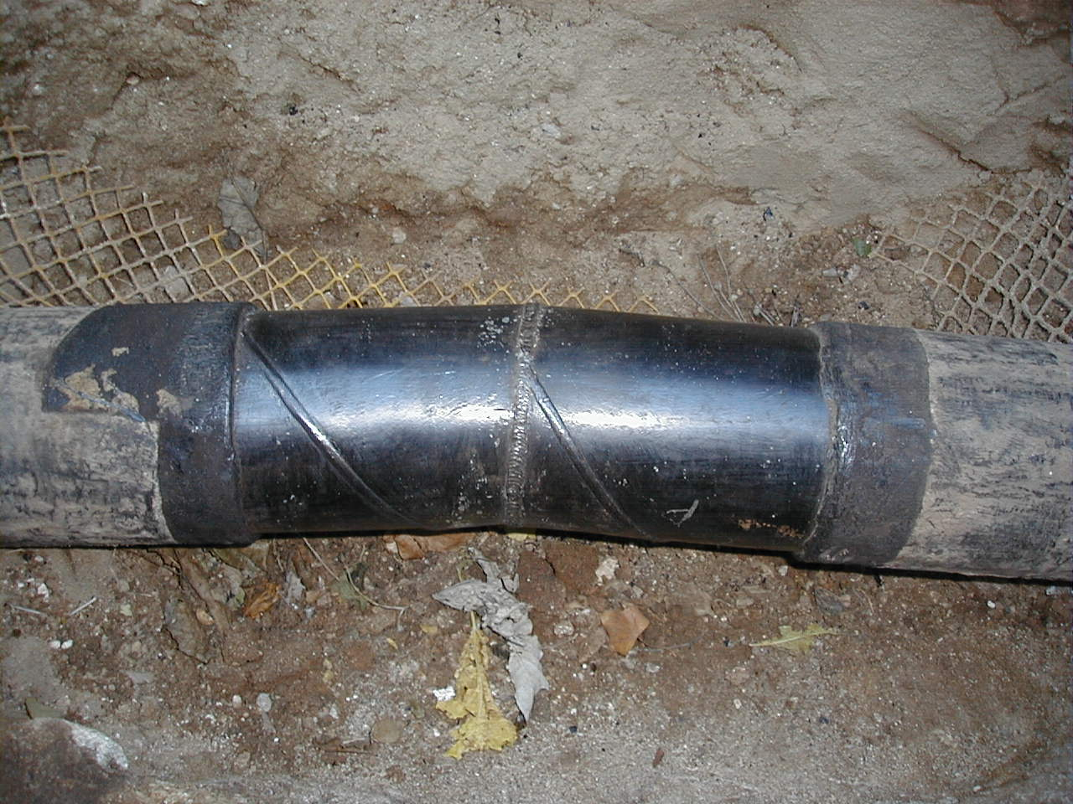
Weld Joint: Unprotected

Slide 20
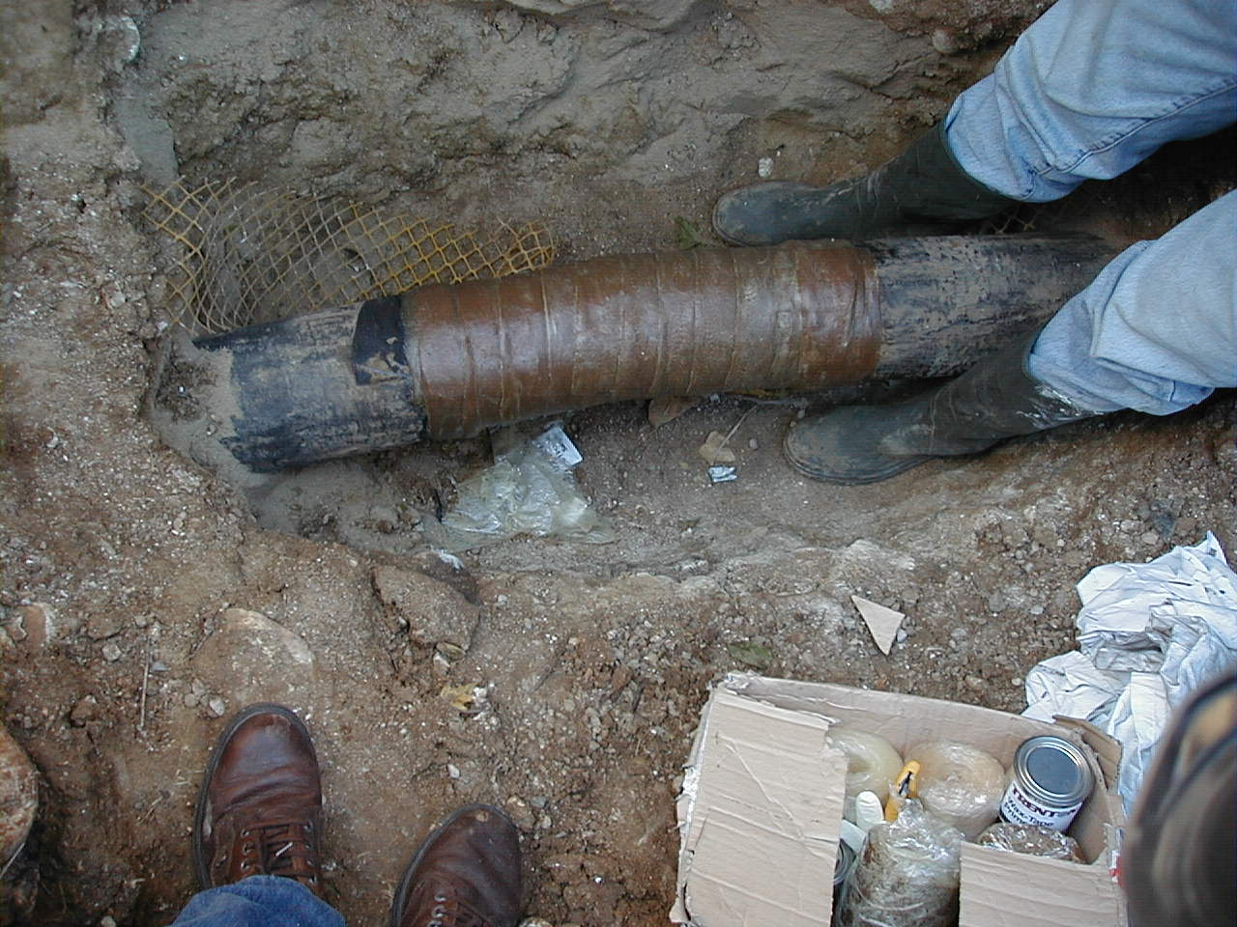
Weld Joint: Primer and Tape Applied

Slide 21
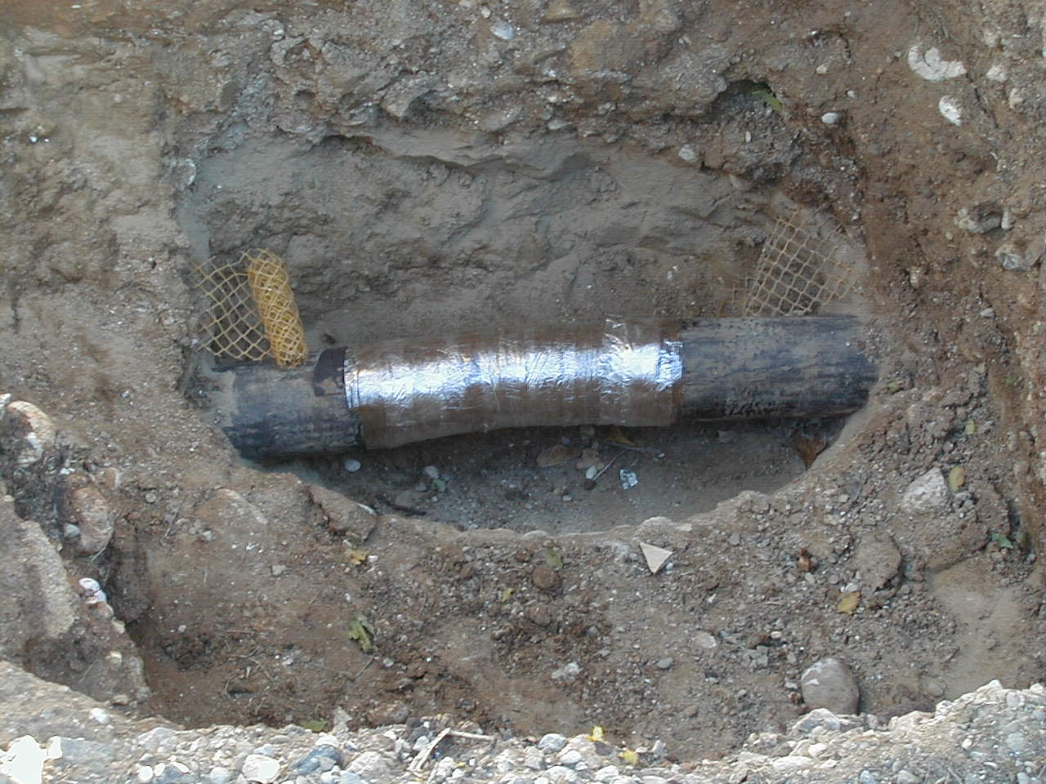
Weld Joint: Outerwrap Applied

Slide 22
Underground Pipe
This wax-based tape application has a moisture-cured outerwrap.

Slide 23
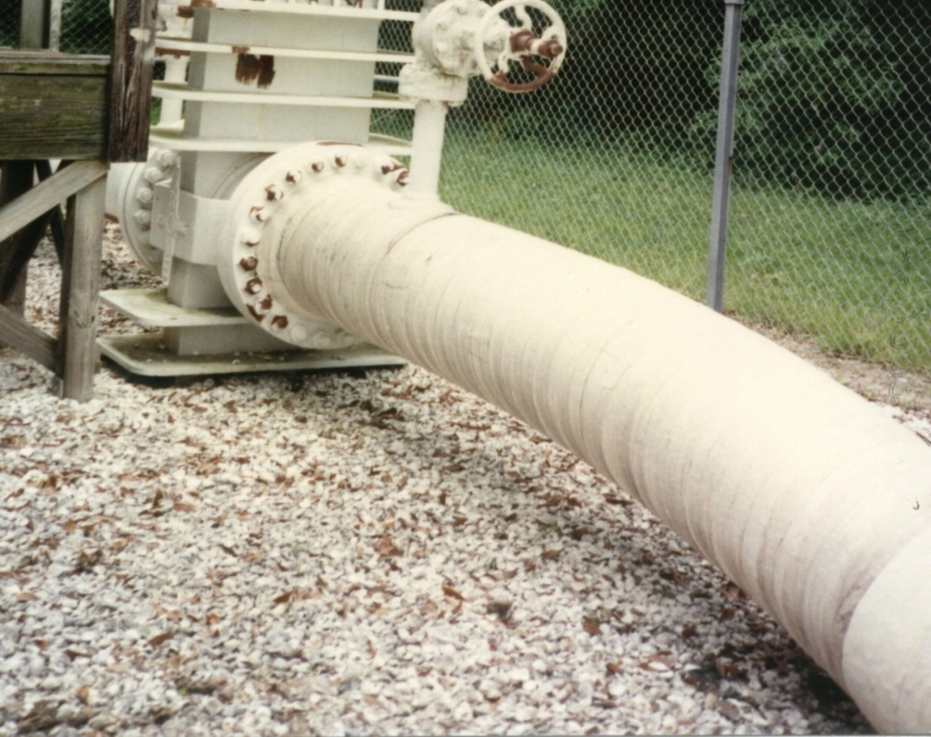
Aboveground Pipe
This photo shows a Gulf Coast micro wax-based tape application after 14 years.

Slide 24
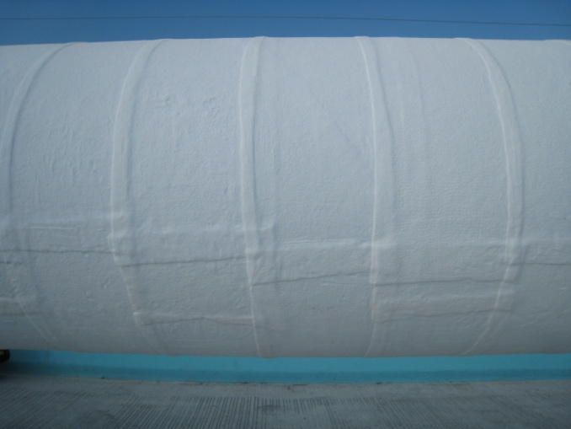
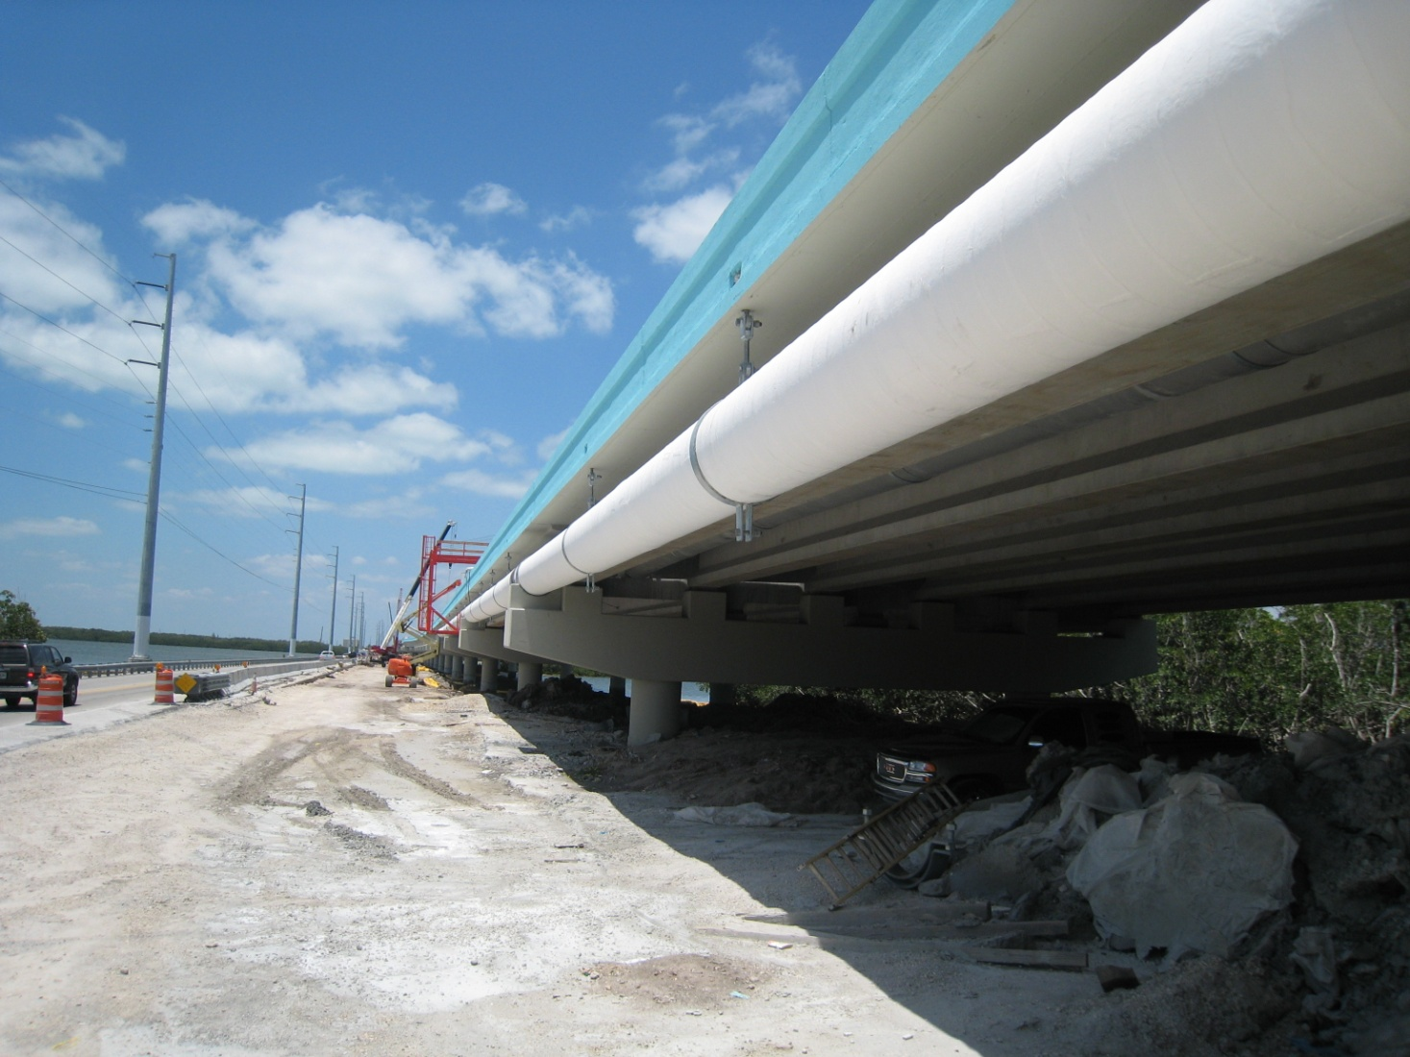
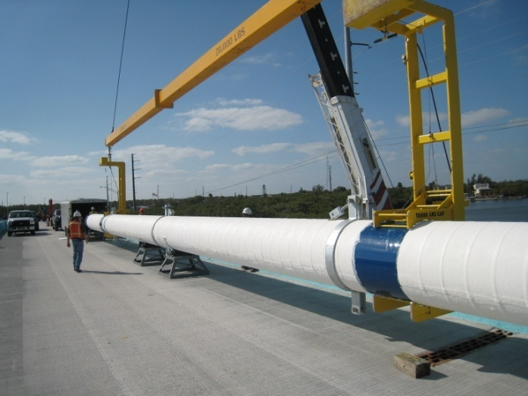
Mile-Long Application over New Pipe

Slide 25
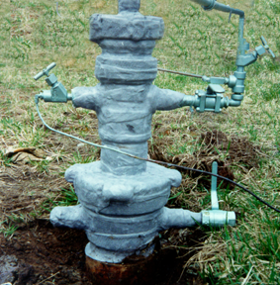
Well Head

Slide 26
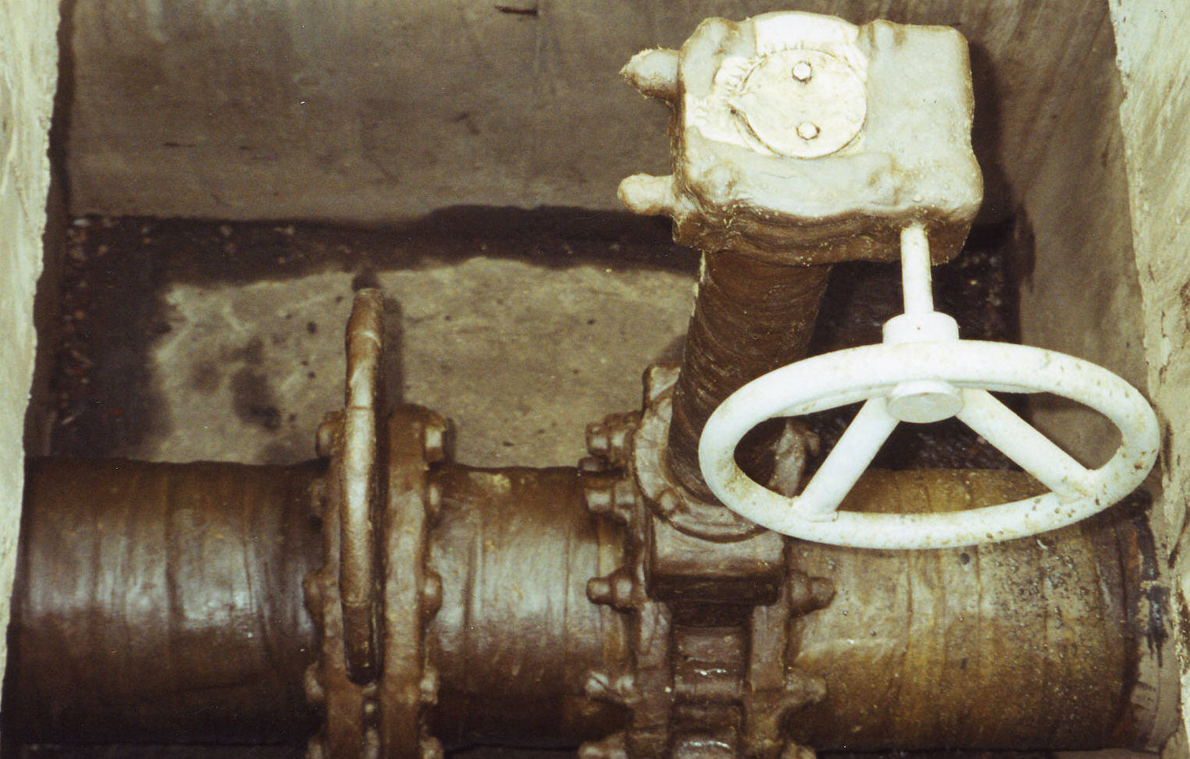
Vaults/Pits/Chamber Application

Slide 27
Risers
A gas company had troubles with FBE coating on risers and used wax-based tape over the FBE coating. Photo on right shows results after seven years.

Slide 28
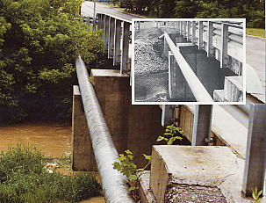
Bridge Span Pipe
Micro wax-based tape protected this Ohio bridge span pipe for 18 years.

Slide 29
Bridge Span Pipe

Slide 30
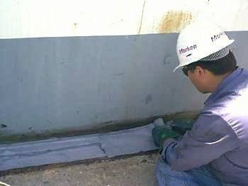
Tank Chime Protection

Slide 31
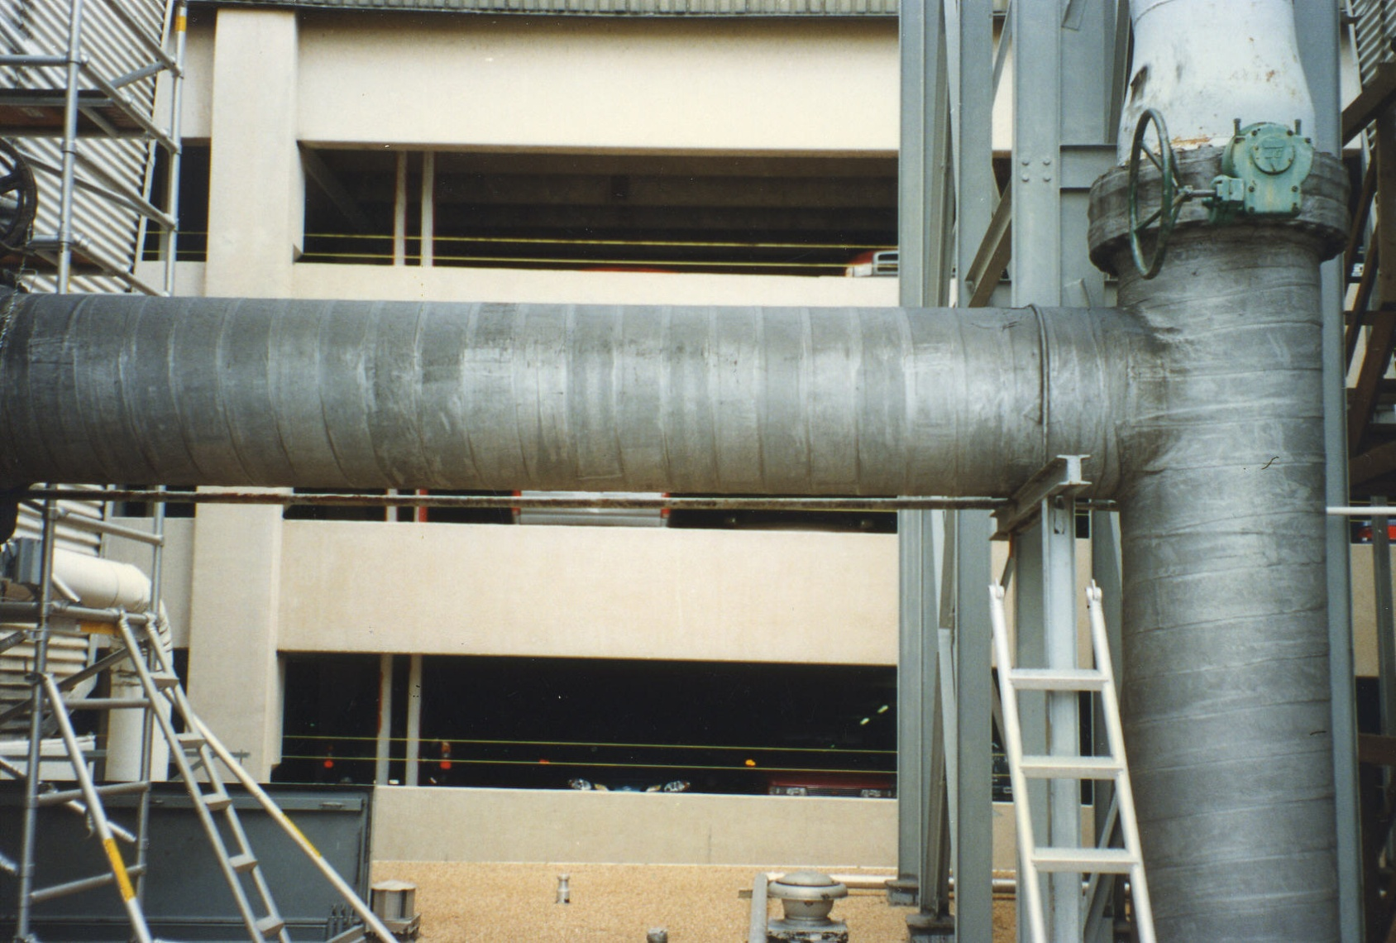
Cooling Tower Piping

Slide 32
Benefits of Wax-Based Tapes
Aboveground and Belowground Benefits:
Easy to apply by unskilled workers
Better application at lower cost
Safe to use, non-toxic
Minimal surface preparation
Chemically inert
Long lasting
May be applied on a wet surface
Conformable to irregular surfaces

Slide 33
Benefits: Belowground and Aboveground
Belowground Benefits:
Resistant to cathodic disbondment
Good dielectric strength
Aboveground Benefits:
UV stable providing years of service
Diverse application environments
“In the northern climates during winter, it’s one of the few products that works.”
Some tapes can be painted after 2 weeks if desired (acrylic latex paint is preferred)
Can be applied over old paint systems if necessary
Can be applied on a sweating pipe

Slide 34
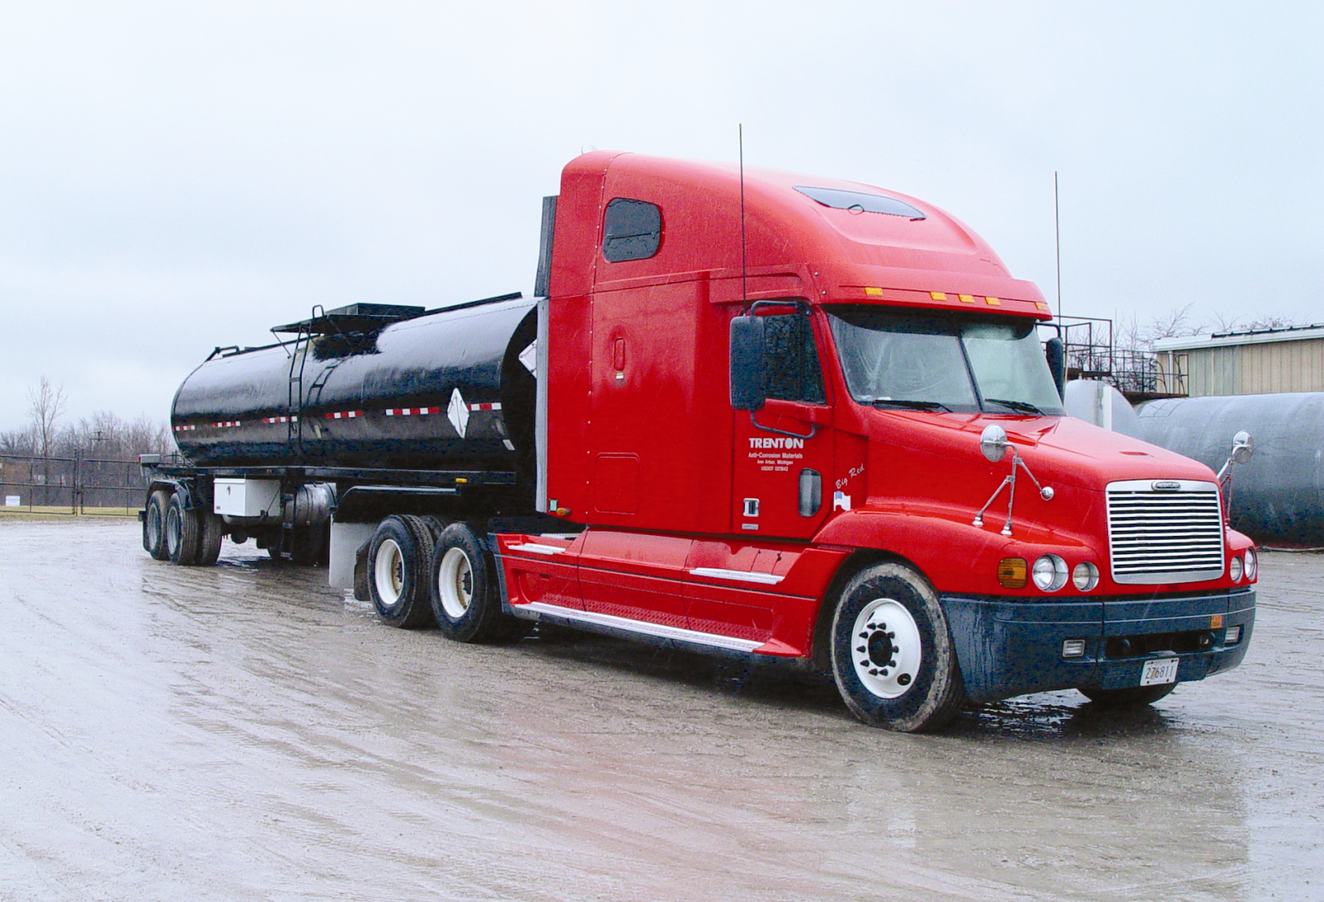
Casing Filling

Slide 35
Casing Filling Process

Slide 36
Benefits of Wax Casing Filling
Anti-corrosive
Water resistant, so it will not absorb or mix with water
Dielectric (electrically non-conductive)
Inert, so it does not degrade or dissolve over time
Non-hazardous, both as to the environment (non-toxic) and handling (non-flammable)
Pliable, resistant to cracking
Remains firm at temperatures at which the facility normally operates (if it were to liquefy, it could leak into the soil through the end seals)
Relatively inexpensive
Easy to install

Slide 37
Hot-Applied Micro Wax

Slide 38
Hot-Applied Micro Wax: Application
Applied in a “flood coat” manner by heating it and pouring it onto the pipe
Overwrapped with protective outerwrap
Final flood coat on top of outerwrap

Slide 39
Hot-Applied Wax

Slide 40
Hot-Applied Wax: Product Features
Used on new pipe or to patch partially or completely deteriorated pipeline coatings in the ditch
No sandblasting required, just SSPC SP-2 surface prep
Non-toxic and no smoke or poisonous fumes
Long lasting, has history of 50 years in North America
Reduced application costs
Saving time & money
Accommodates pipe expansion, contraction and flexing
Unused product can be reheated and used again (unlimited shelf life)
Diverse application environments (used over wide temperature ranges)

Slide 41
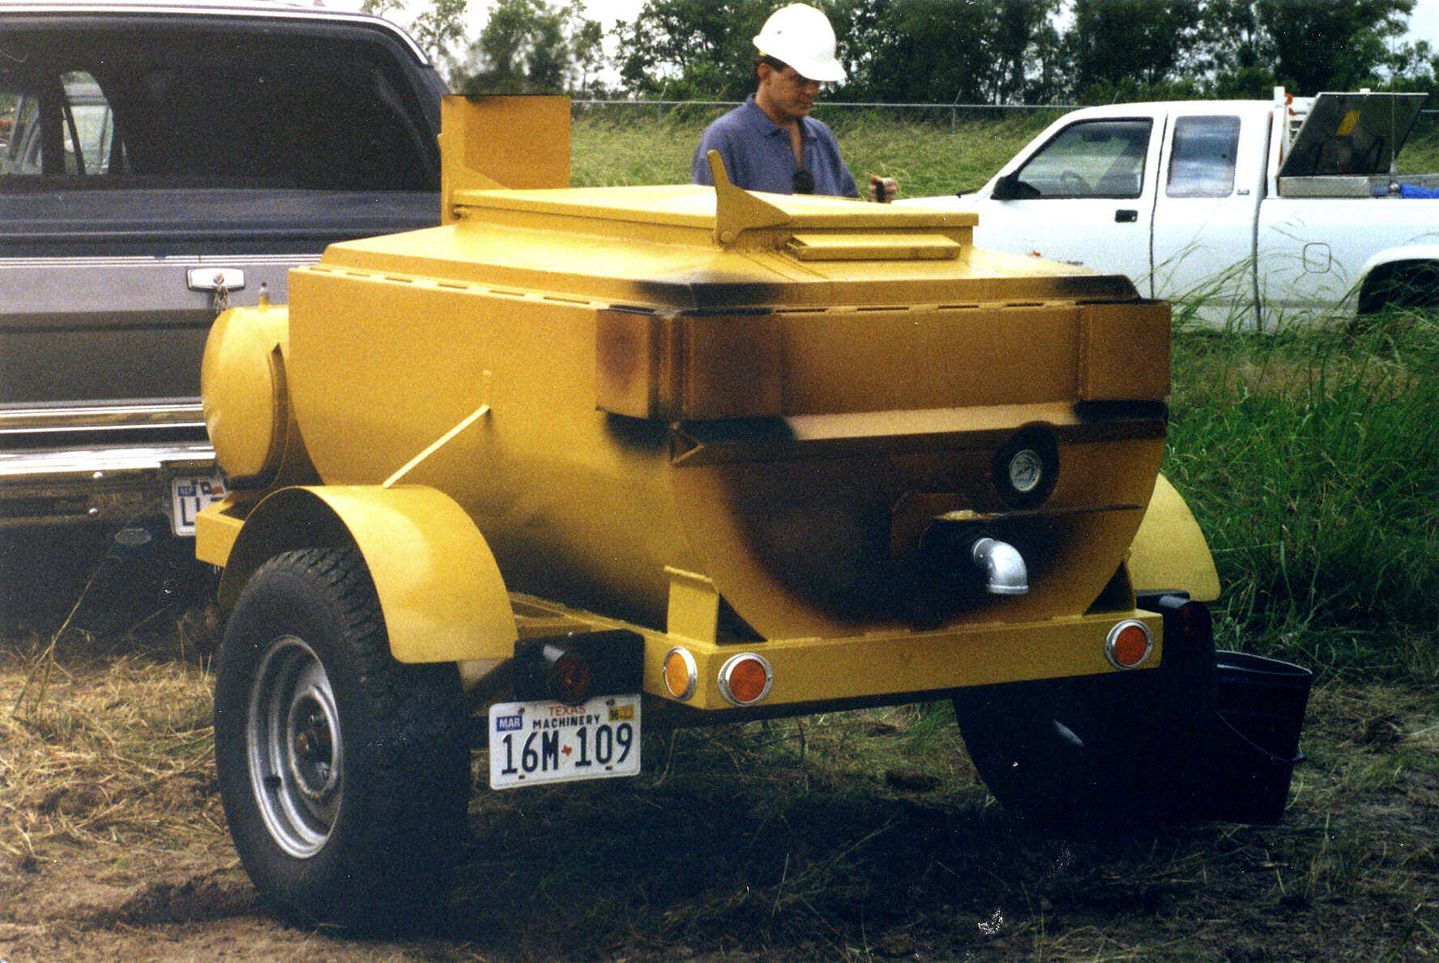
Application Procedure
Wax is heated to 250 to 350 degrees F in a kettle or dope pot.

Slide 42
Hot-Applied Wax Outerwrap

Slide 43
Hot Wax & Outerwrap Applied

Slide 44
Reconditioning a Coal Tar Coated Pipe

Slide 45
Girth Weld Application: Unprotected

Slide 46
Hot Wax is Poured over the Weld

Slide 47
2nd Coat of Hot Wax over the Outerwrap

Slide 48
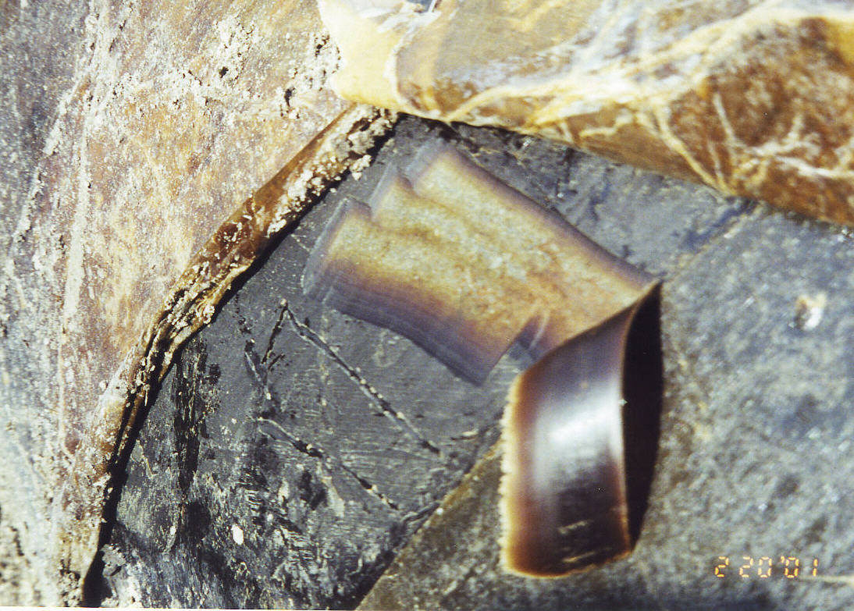
Hot-Applied Wax: Followup
After 10 years in service, pipe and wax are still in excellent condition.

Slide 49
Hot-Applied Wax: Followup
After 50 years with hot wax, pipe showed virtually no corrosion. Wax literally could have been re-melted and reused.

Slide 50
Hot-Applied Micro Wax for Pipes
Benefits:
Low moisture absorption & transmission rates (resists moisture)
Good surface wetting
Permanent flexibility
Excellent adhesion
Chemically inert
Resilience under impact
Cost effective (unused wax can be reheated)

Slide 51
Wax Coatings Technical Recognition
NACE RP 0375-06 Wax Coating Systems for Underground Piping Systems
AWWA C217-09
Wax coatings are approved in numerous oil and gas pipeline coatings manuals and in various international standards

Slide 52
Summary on All Wax Coatings:
Effective in mitigating corrosion
Easy on the workers and the environment
Low surface prep
Ease of application improves reliability of application
Low total cost of application
Long lasting, successfully used for over 60 years

Slide 53
Questions?

