Slide 1
Pipeline Coating Selection Based On Application
Presented by Jim Utley

Slide 2
QUALITIES OF A PIPELINE COATING
Coating must possess excellent adhesion and cohesion to steel substrate
Coating must have good dielectric strength
Coating must be impervious to water absorption
Coating must have good hardness characteristics and shear strength for HDD applications
Coating must be compatible with other coatings

Slide 3
TYPES OF FIELD COATINGS
Polyethylene/Butyl Cold-Applied Tape, Coal-Tar/Bitumen Tape and Liquid Mastic
Petrolatum/Wax Type Coatings w/ appropriate outer wraps
Liquid Two-Part Epoxy (100% Solids)- Plural Component Spray and Brush-Applied Kits
Coal-Tar Epoxies
Powder Type Fusion-Bond Epoxy (Flocking in the Field)
Heat-Shrink Sleeves (Tubular+ Split-Sleeve)

Slide 4
Coating Selection Based On Field Conditions
Type of Conditions: New Construction vs. Maintenance of Operating/ In-Service Lines (Sweaty Pipe, Cold Pipe/Temps., Discharge Lines, etc.)
Degrees of Surface Preparation, SP #1,2,3, SP#6, SP#9,10 (NACE 2)
Atmospheric Conditions During Product Application
Type of New Install (Directional Bore vs. Direct Burial)
Experience of Field Coating Crews with product (Pipeline Contractor vs. Company Crews)
Supporting Data and Historical Experience With the Use of a Particular Coating System (pig-runs, surveys, DCVG, direct assessment techniques, etc.)

Slide 5
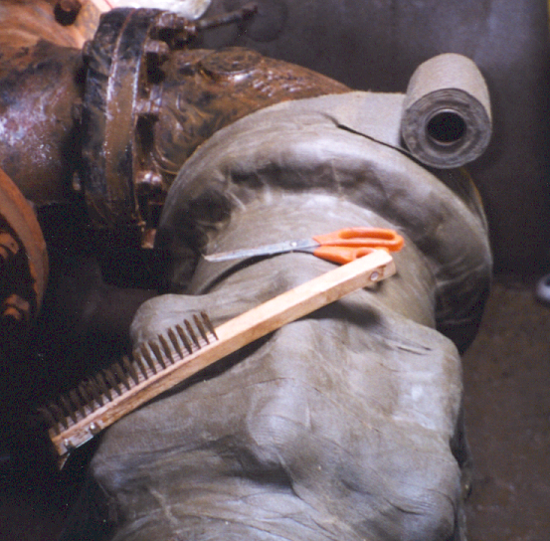
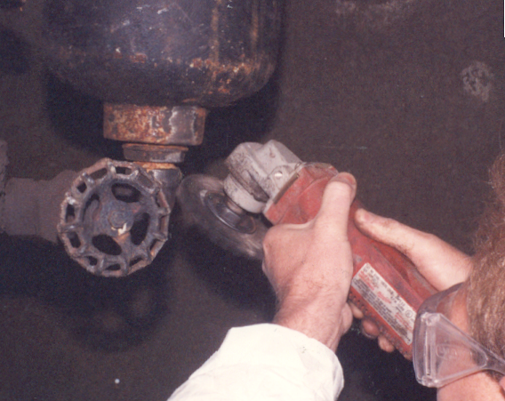
Tools required for petrolatum/ wax tape application and surface preparation.

Slide 6
Thin layer of paste primer applied to surface.

Slide 7
Profiling Mastic used for irregular profiles.

Slide 8
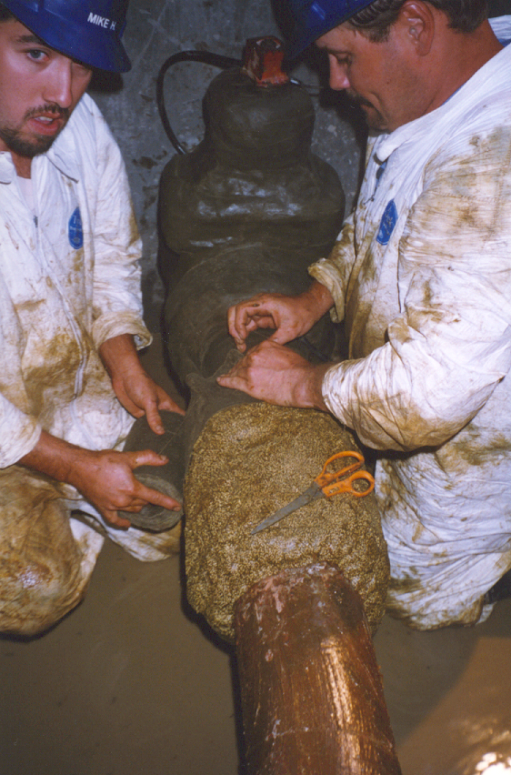
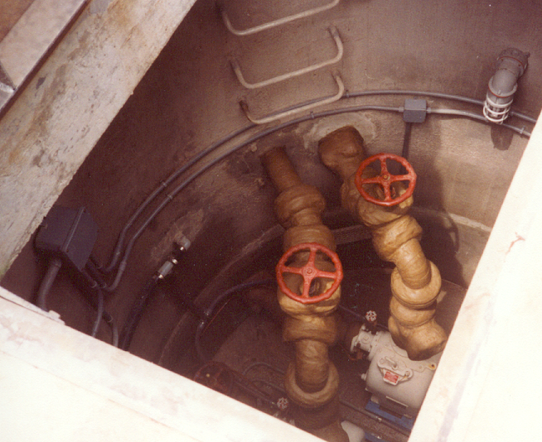
Protection of vault piping with petrolatum/ wax tape system.

Slide 9
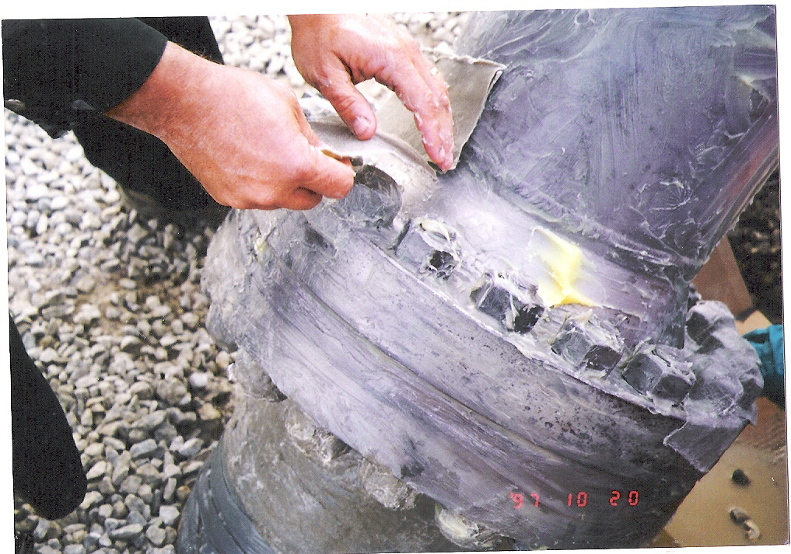

Slide 10
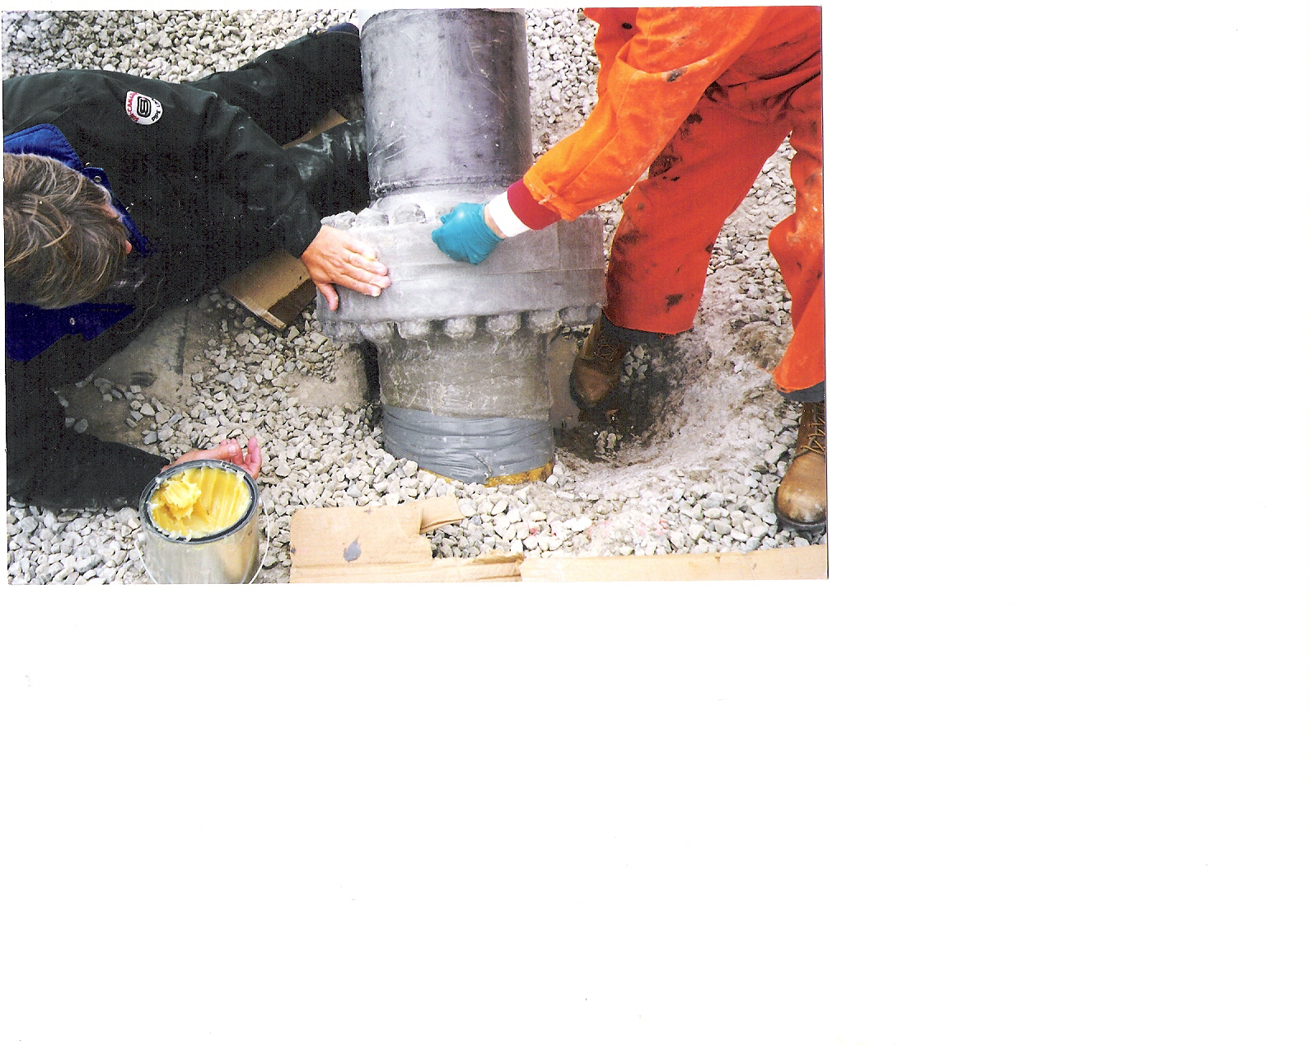

Slide 11
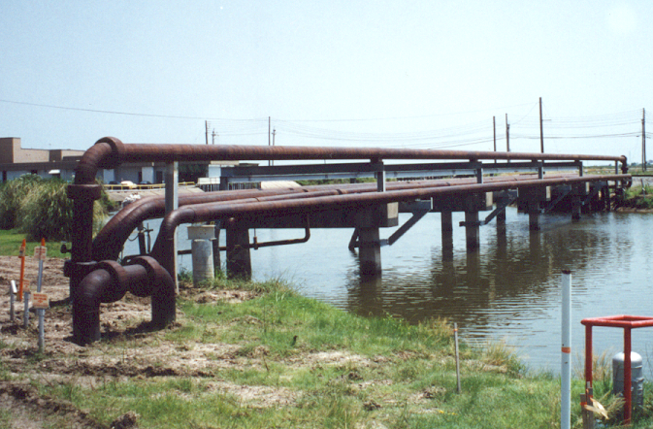
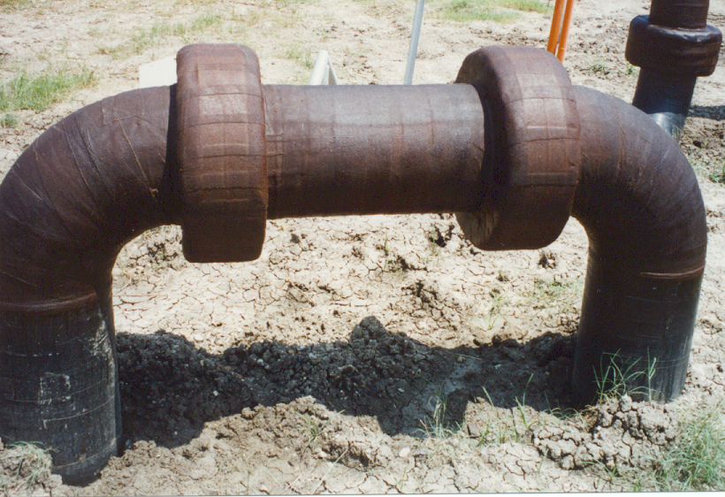
Cold-applied petrolatum/wax tape applied to above-ground river crossing.

Slide 12
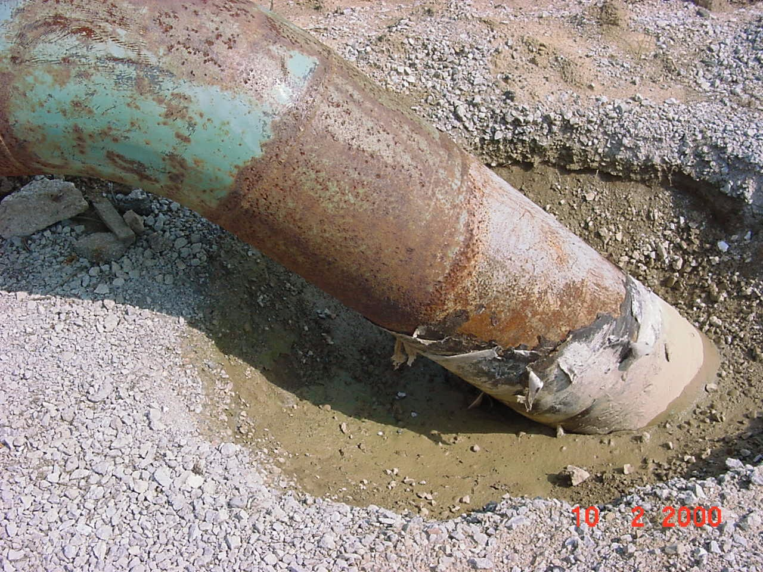
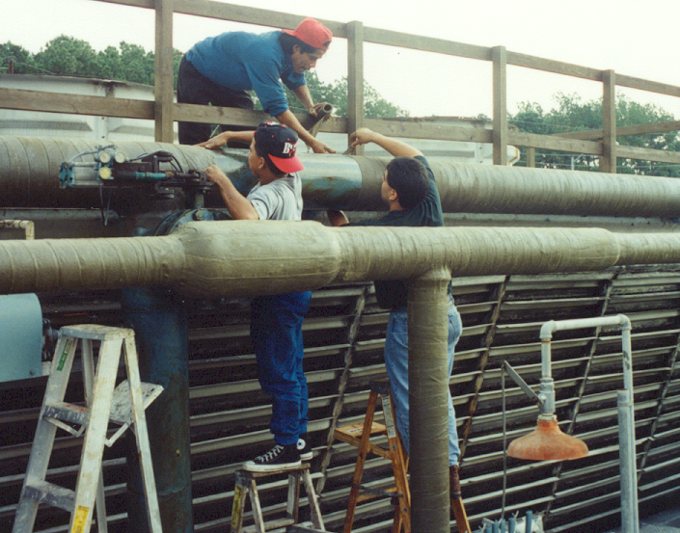
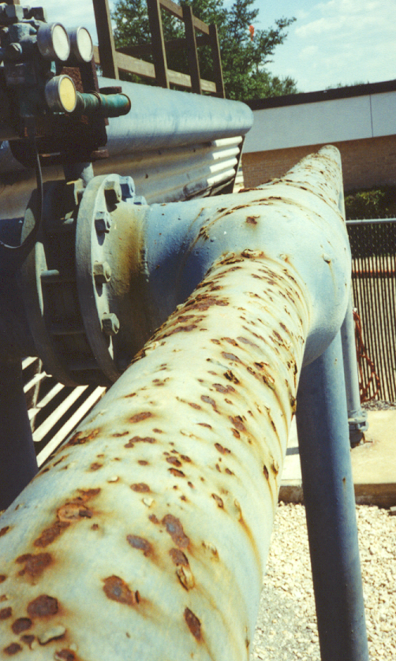
Petrolatum/wax tape system applied to cooling tower piping, valves, flanges, etc.

Slide 13
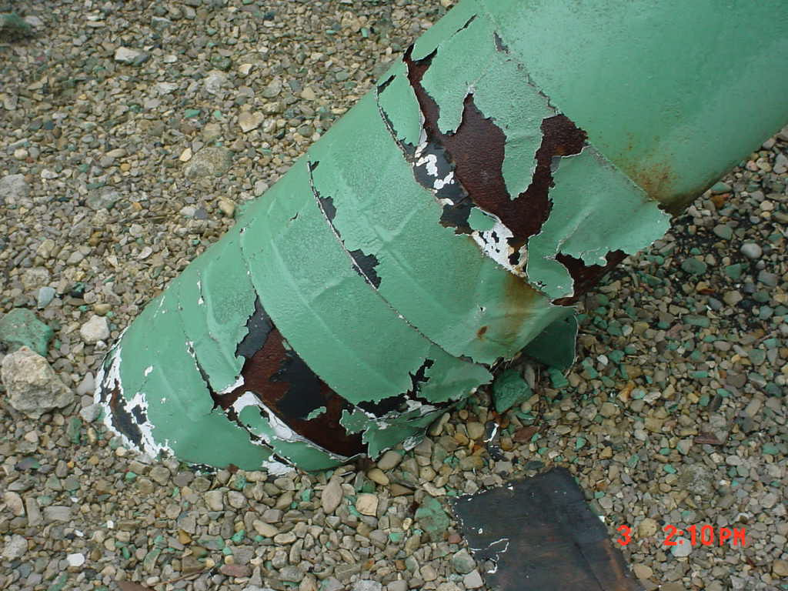

Slide 14
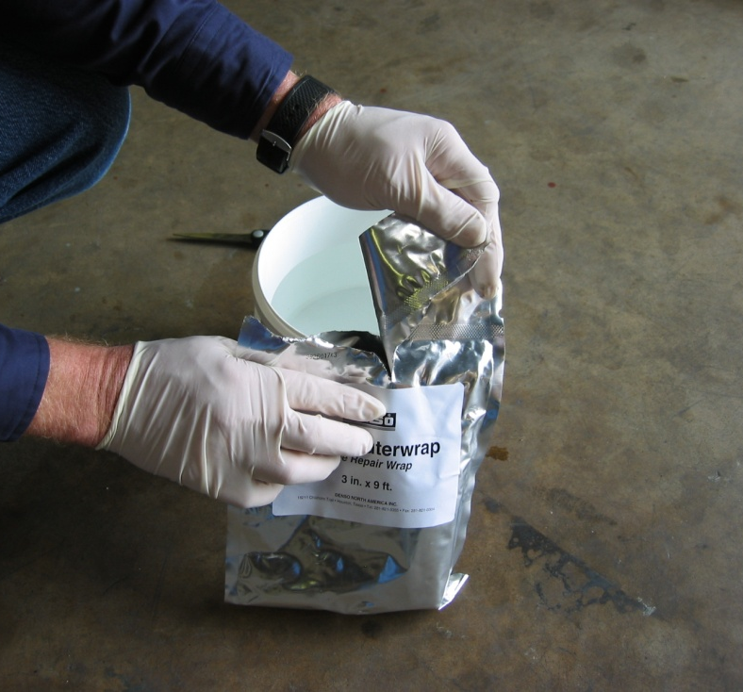
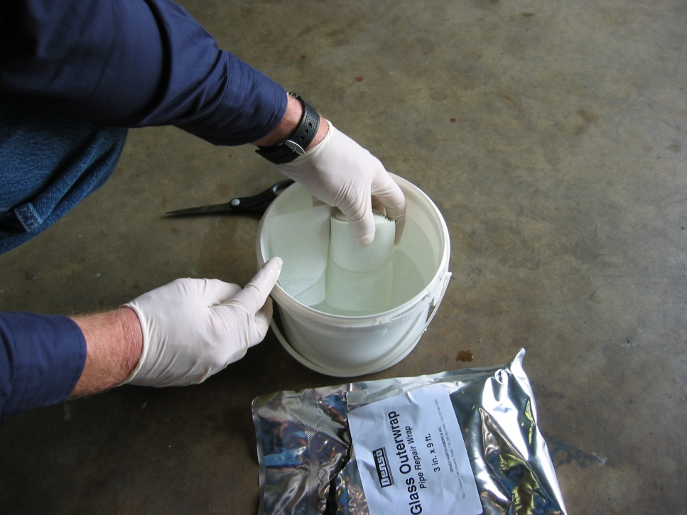
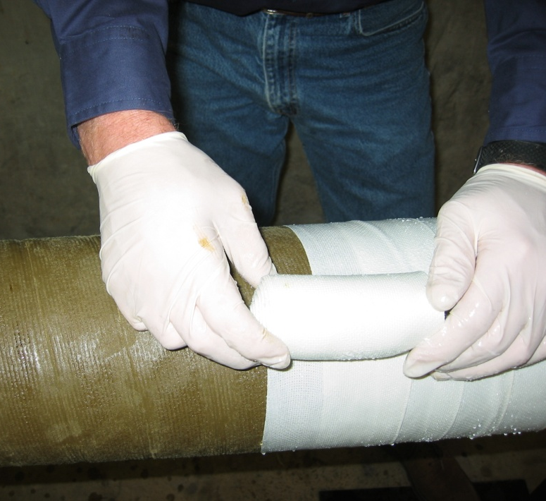
Remove roll from hermetically sealed foil pouch.
Fiberglass Water Activated Glass Outerwrap
Place roll in water for 20 to 30 seconds.
Spirally wrap with a 50% + overlap.

Slide 15
Wind line area protected with petrolatum tape and a glass outerwrap.

Slide 16
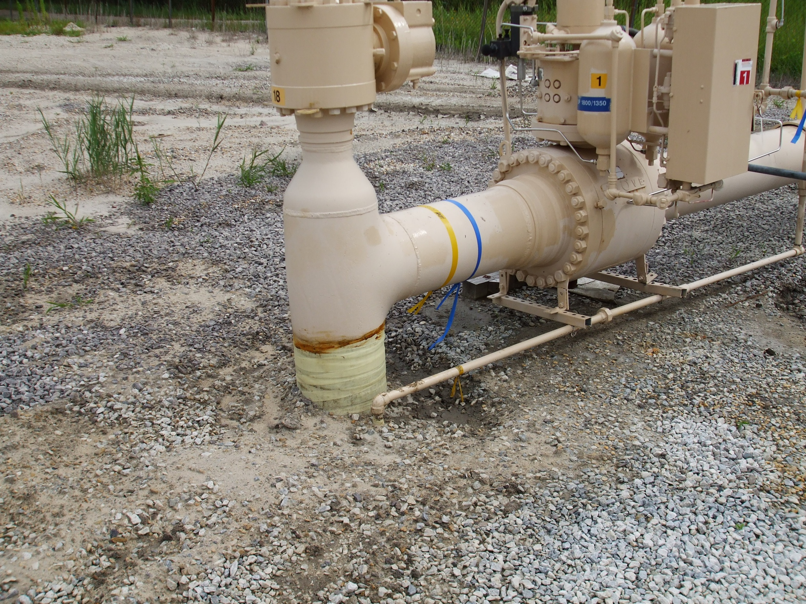

Slide 17
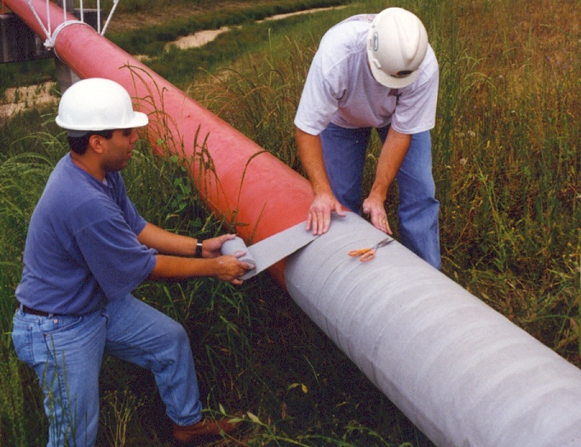
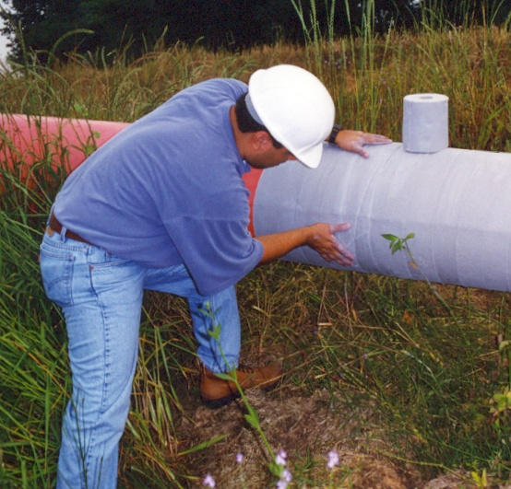
Grey wax/petrolatum tape - Applied on a pipeline span

Slide 18
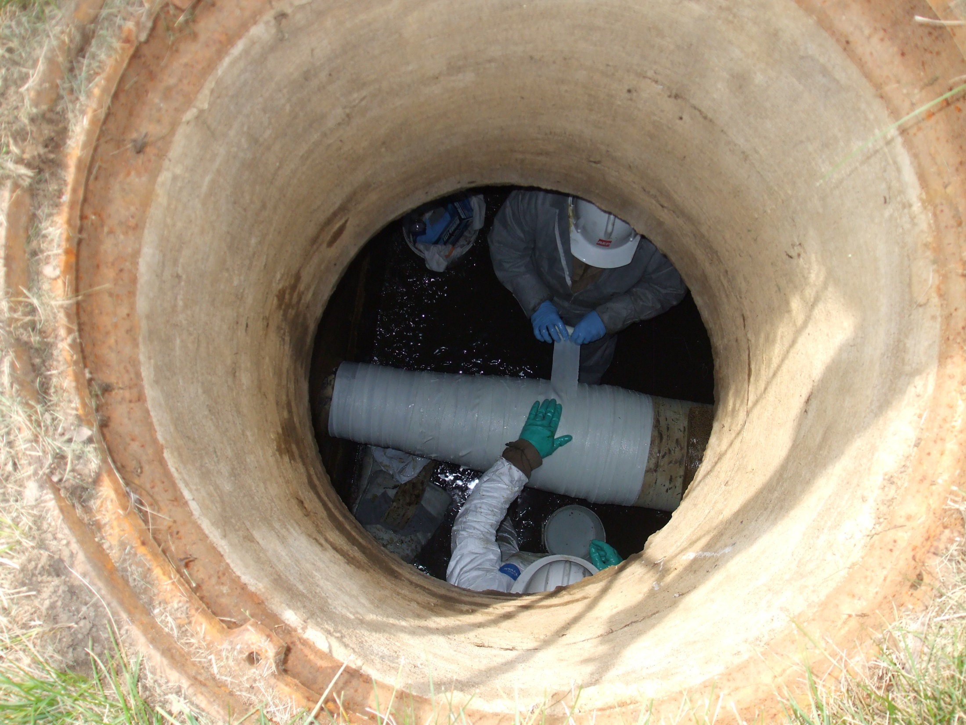

Slide 19
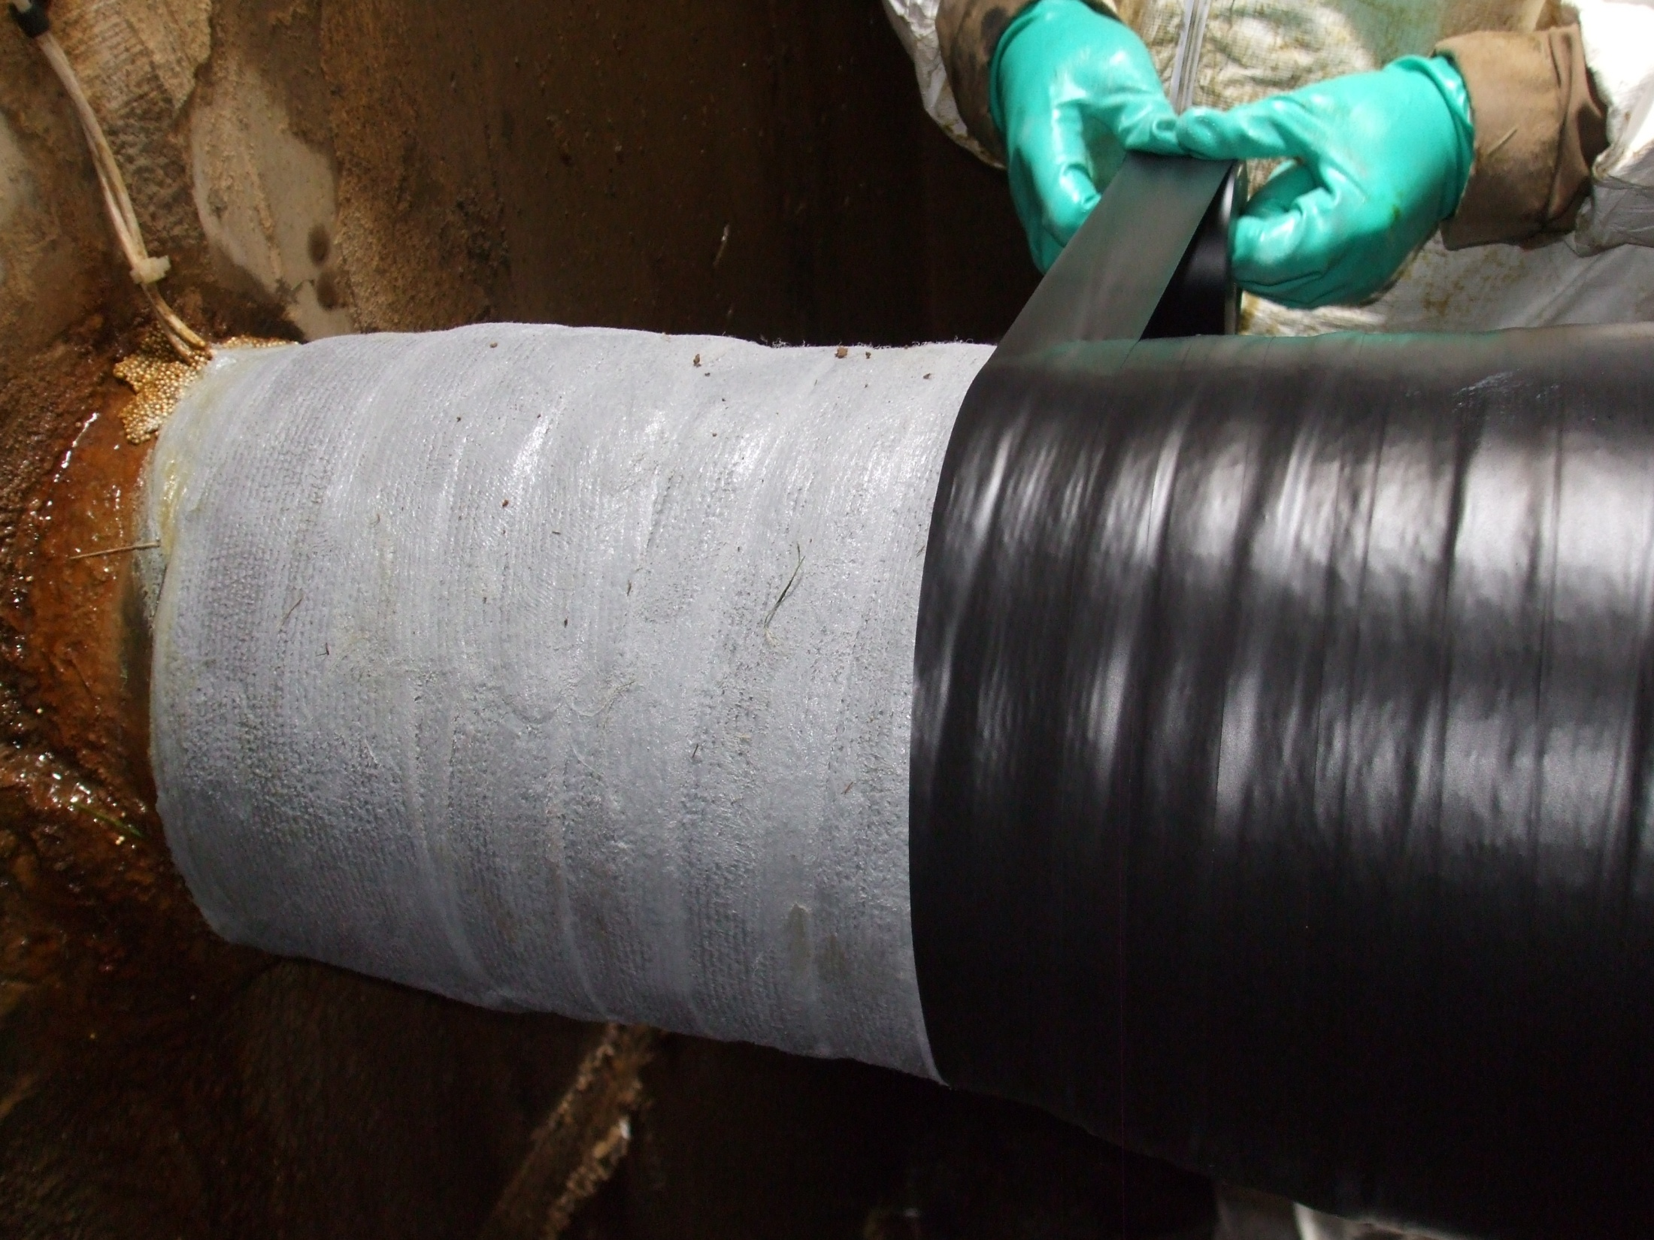

Slide 20
Primer being applied with a roller.

Slide 21
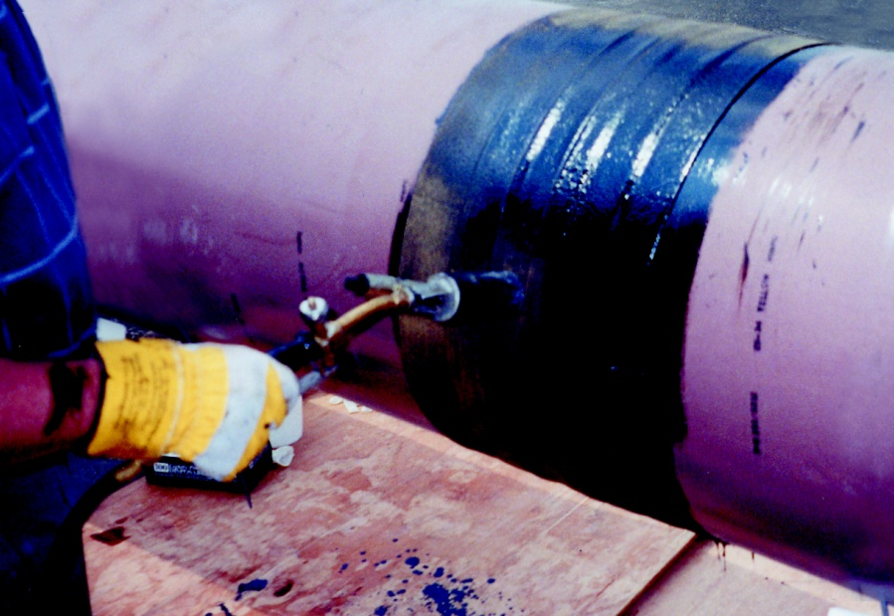
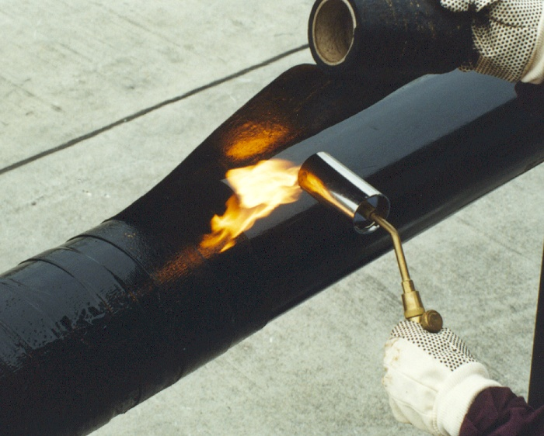
Hot-Applied BitumenTape 80 mil hot applied tape, excellent in cold temperatures and where extra hardness is required.

Slide 22
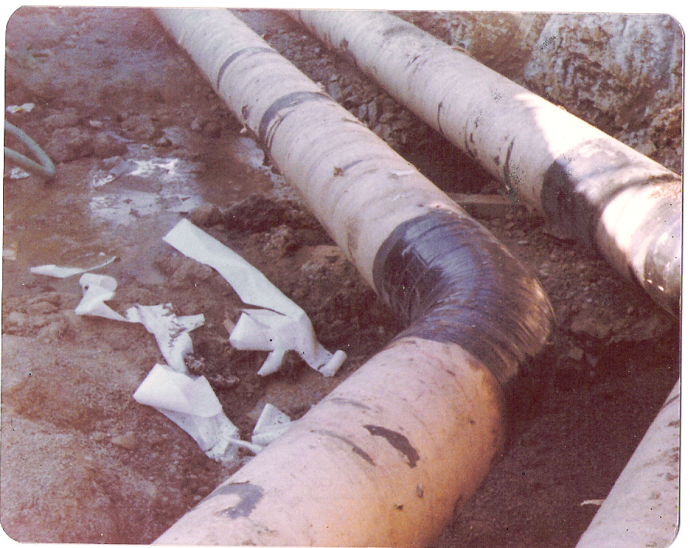

Slide 23
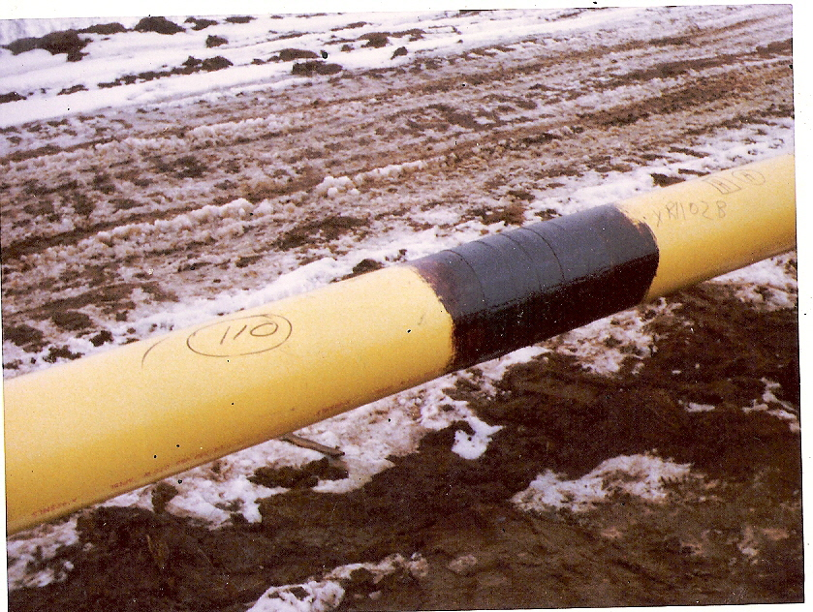

Slide 24
60 mil cold-applied tape used to repair and rehab existing pipeline.

Slide 25
Surface Preparation Grit blasted to SSPC SP-10 or NACE 2.

Slide 26
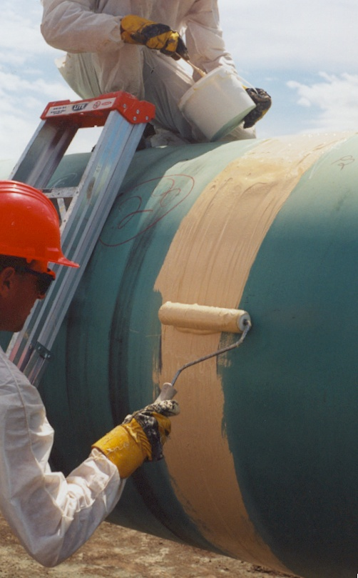
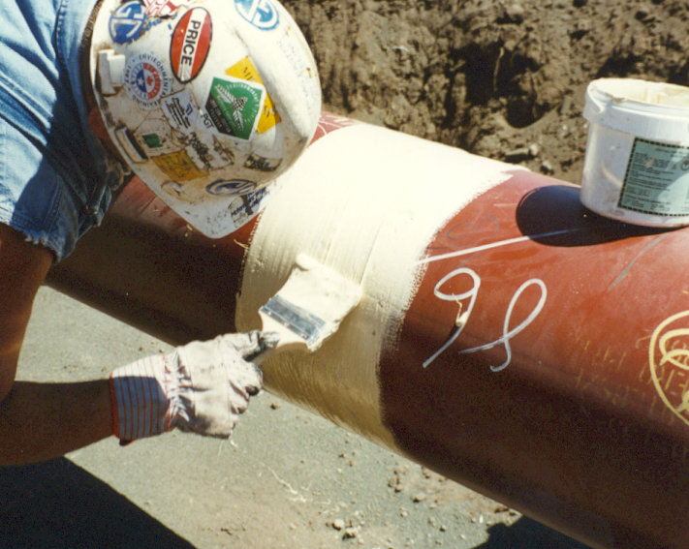
High Build 100% Solids Liquid Epoxy Coating Applied to girth weld at 25 - 30 mils.

Slide 27
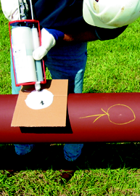
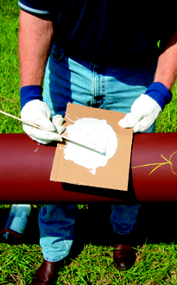
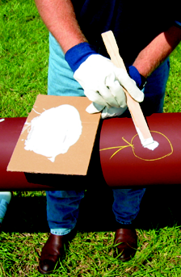
100% Solids Liquid Coating in Repair Cartridge Form Repairs to FBE, cadwelds, etc.

Slide 28
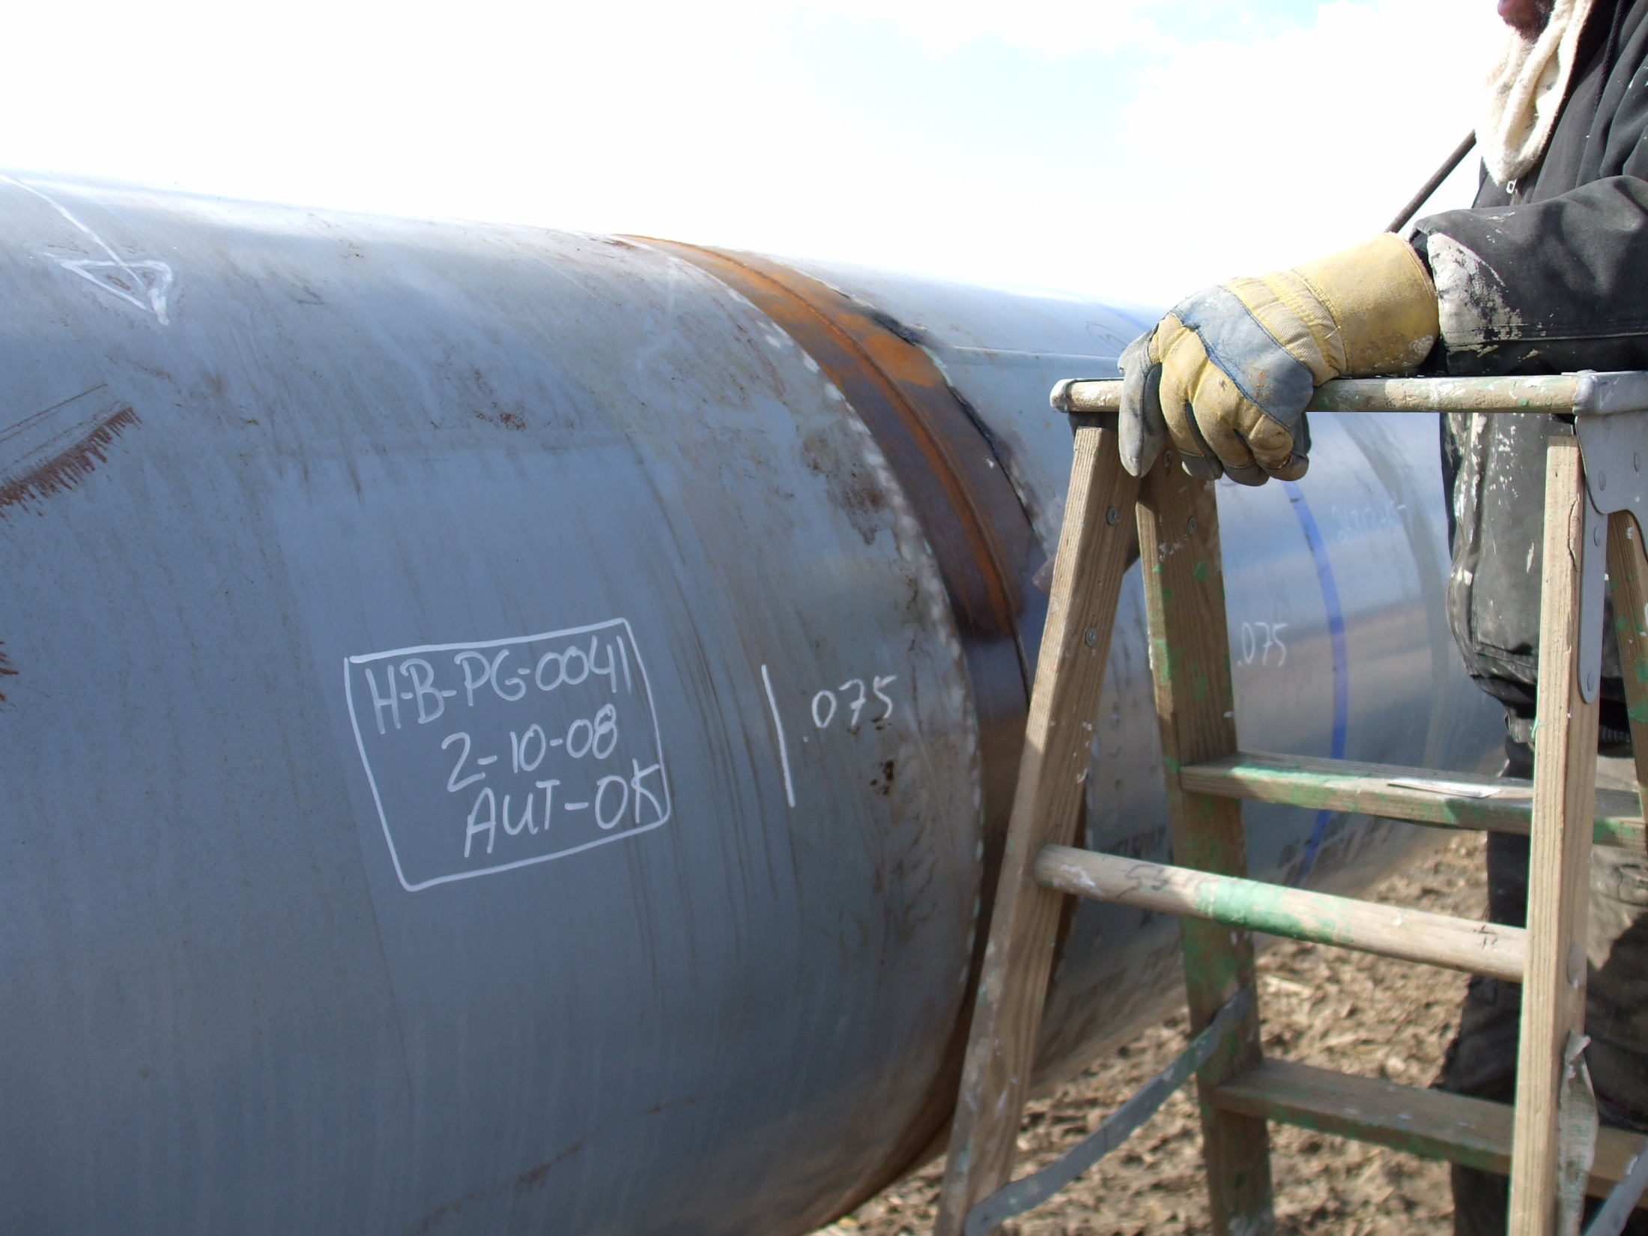

Slide 29
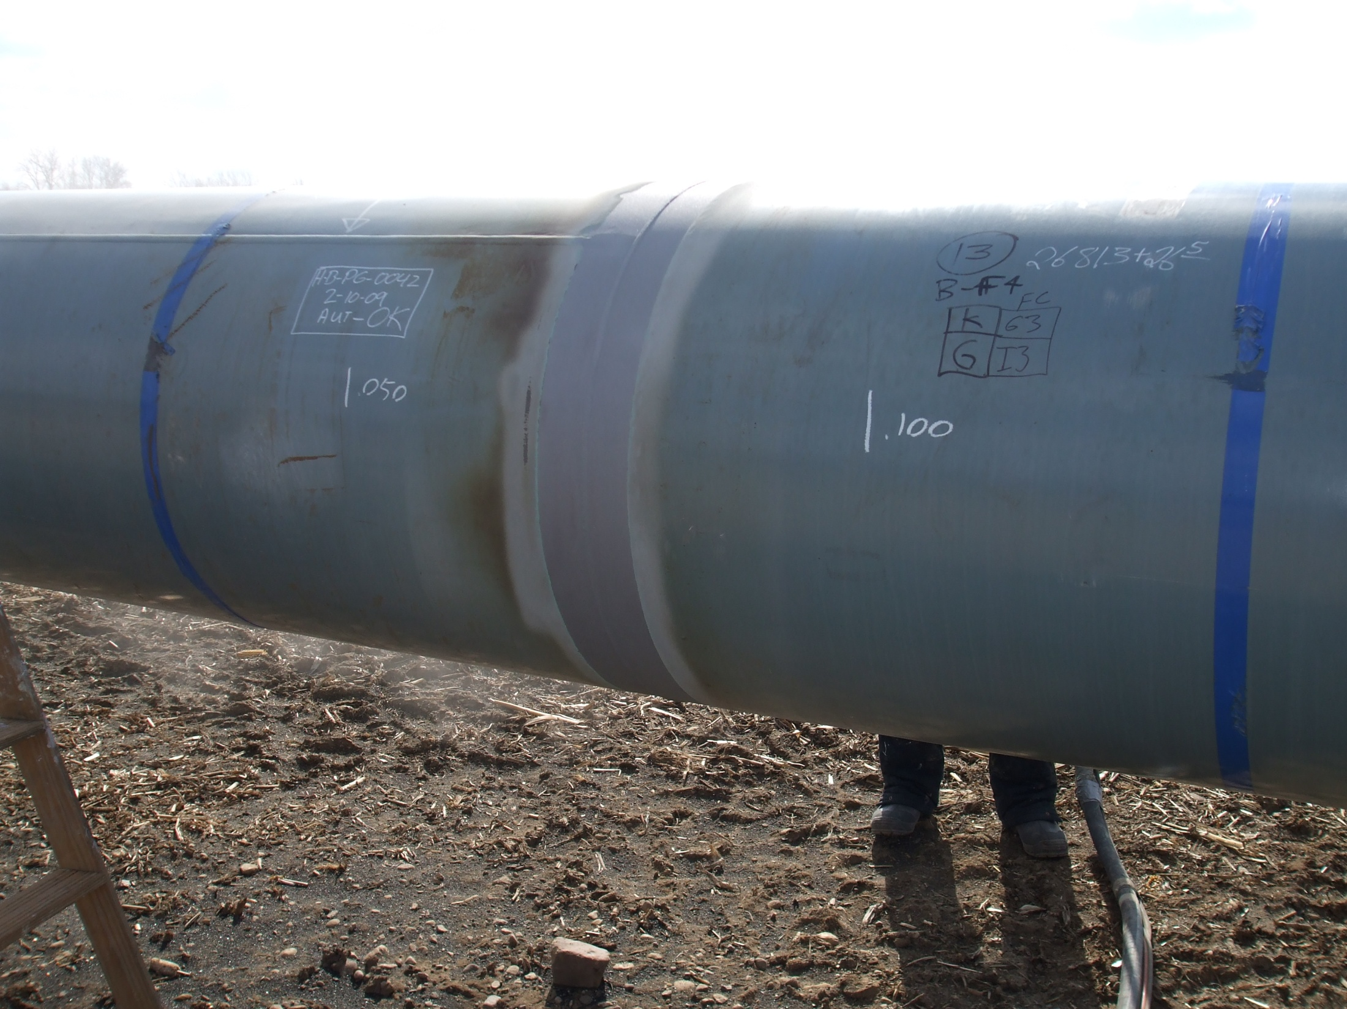

Slide 30
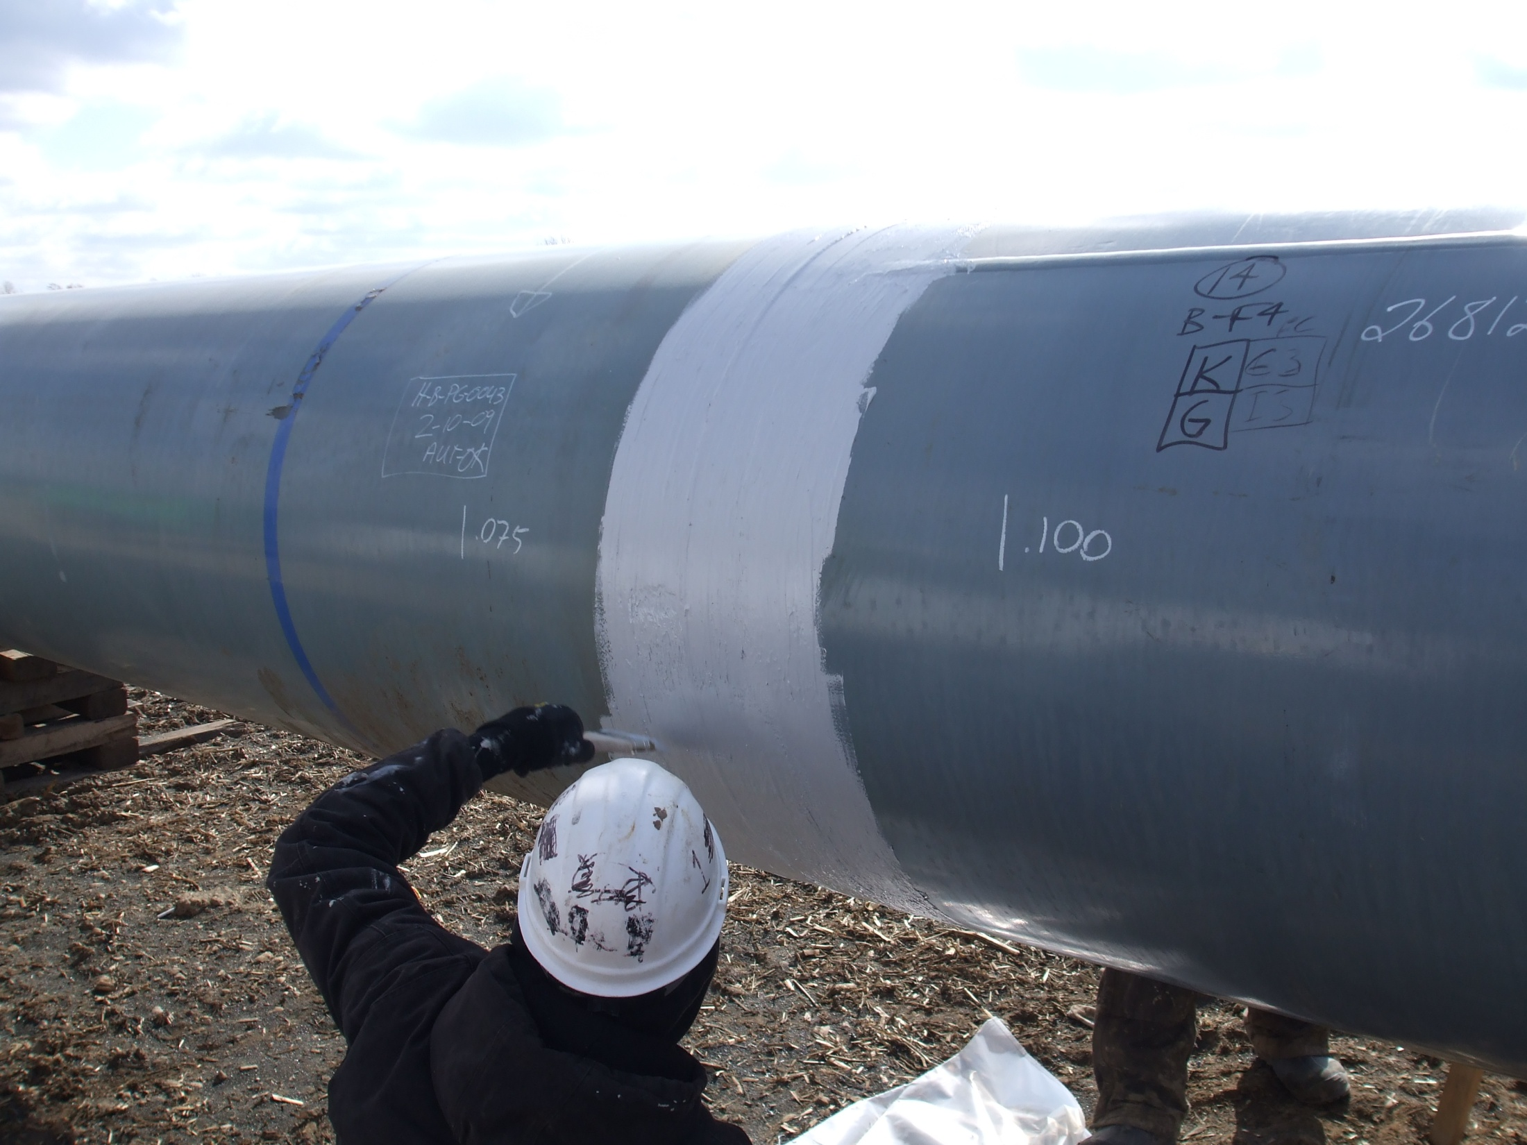

Slide 31
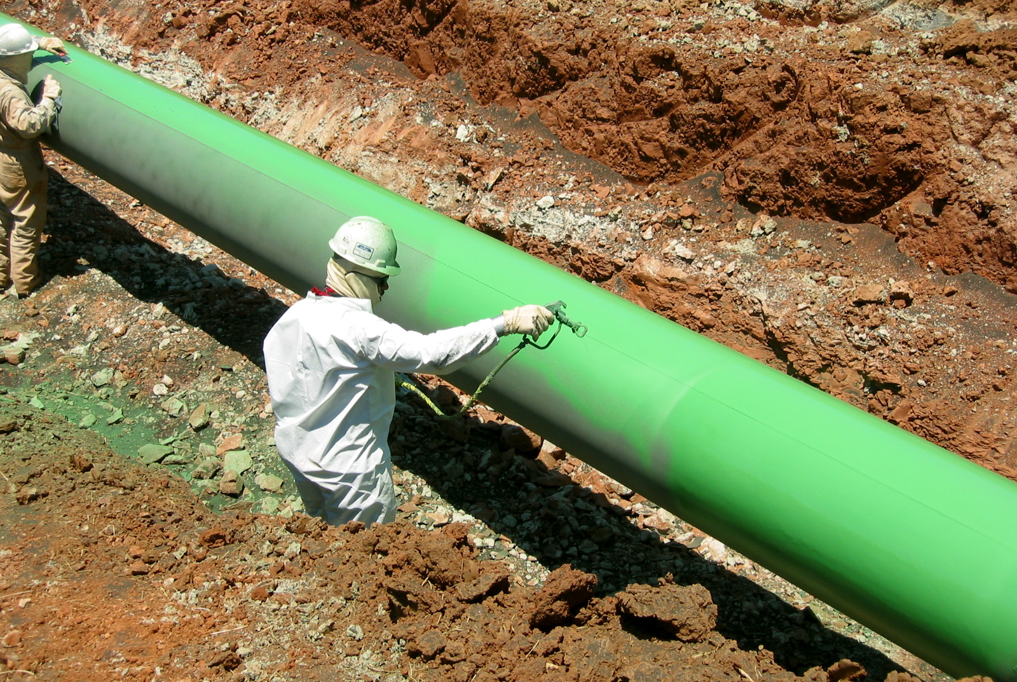
100% Solids Liquid Spray-Applied Epoxy Coating - Applied with a plural component unit with 3:1 spray equipment.

Slide 32
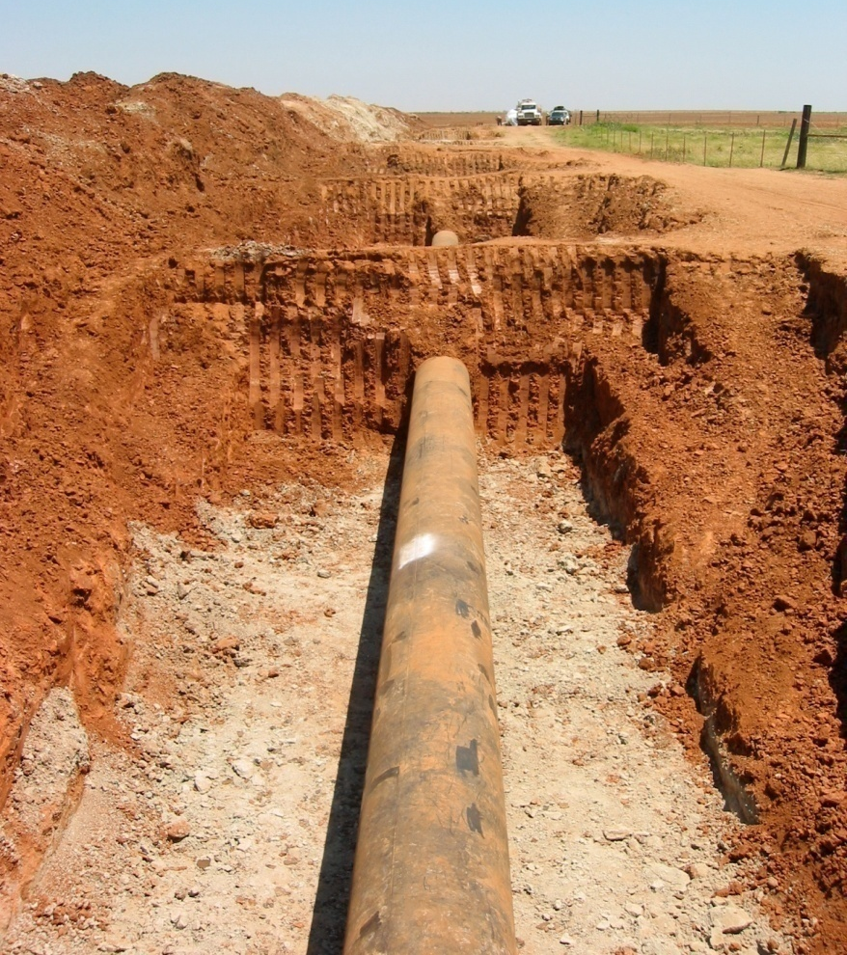
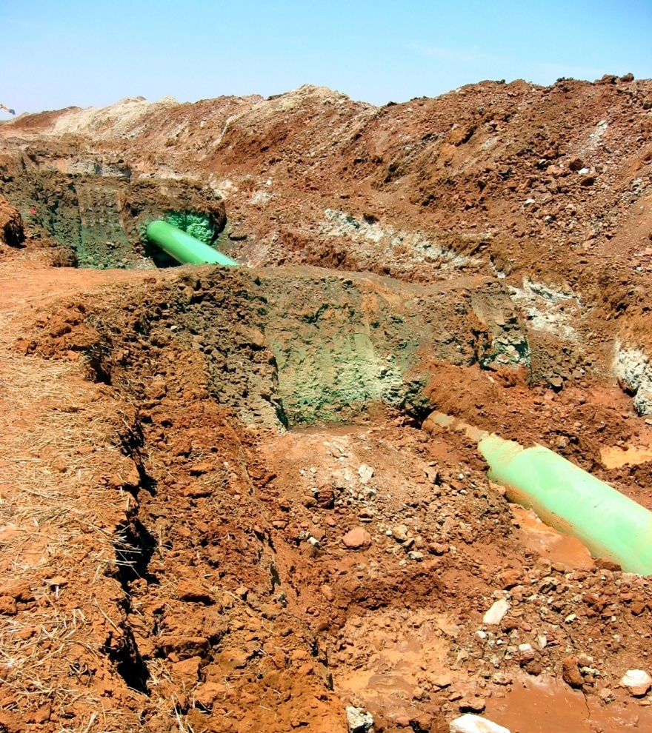
100% Solids Liquid Epoxy Coating - Bell hole rehab - before and after.

Slide 33
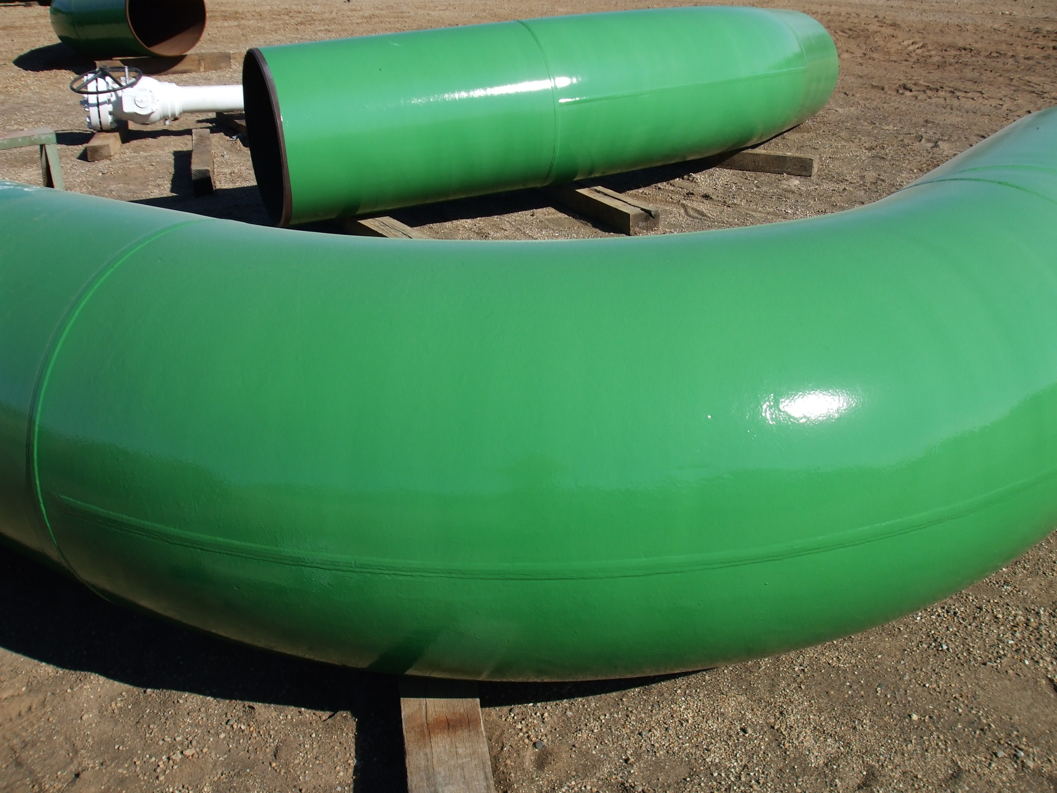

Slide 34
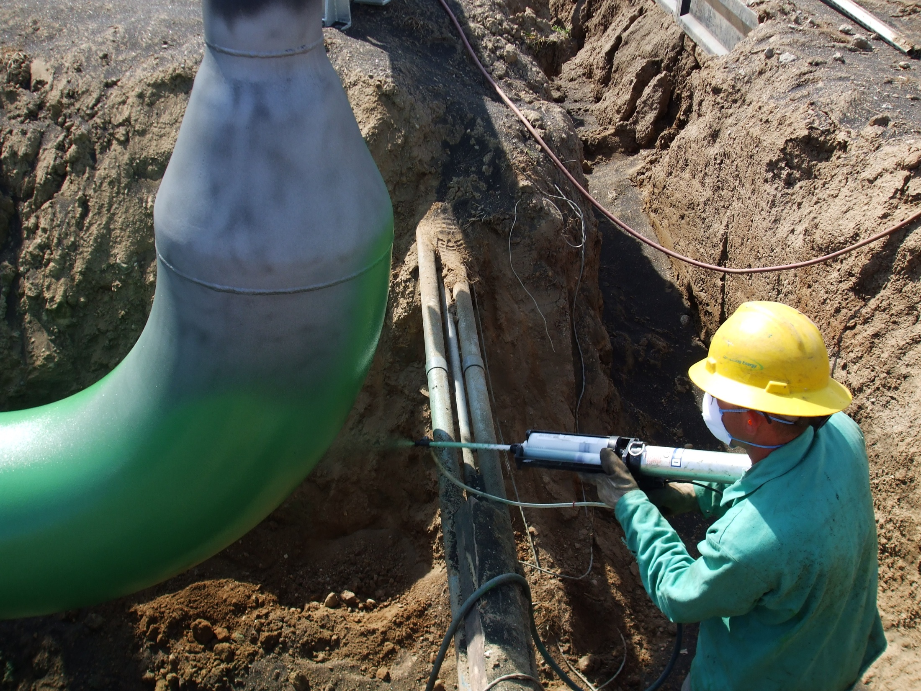

Slide 35
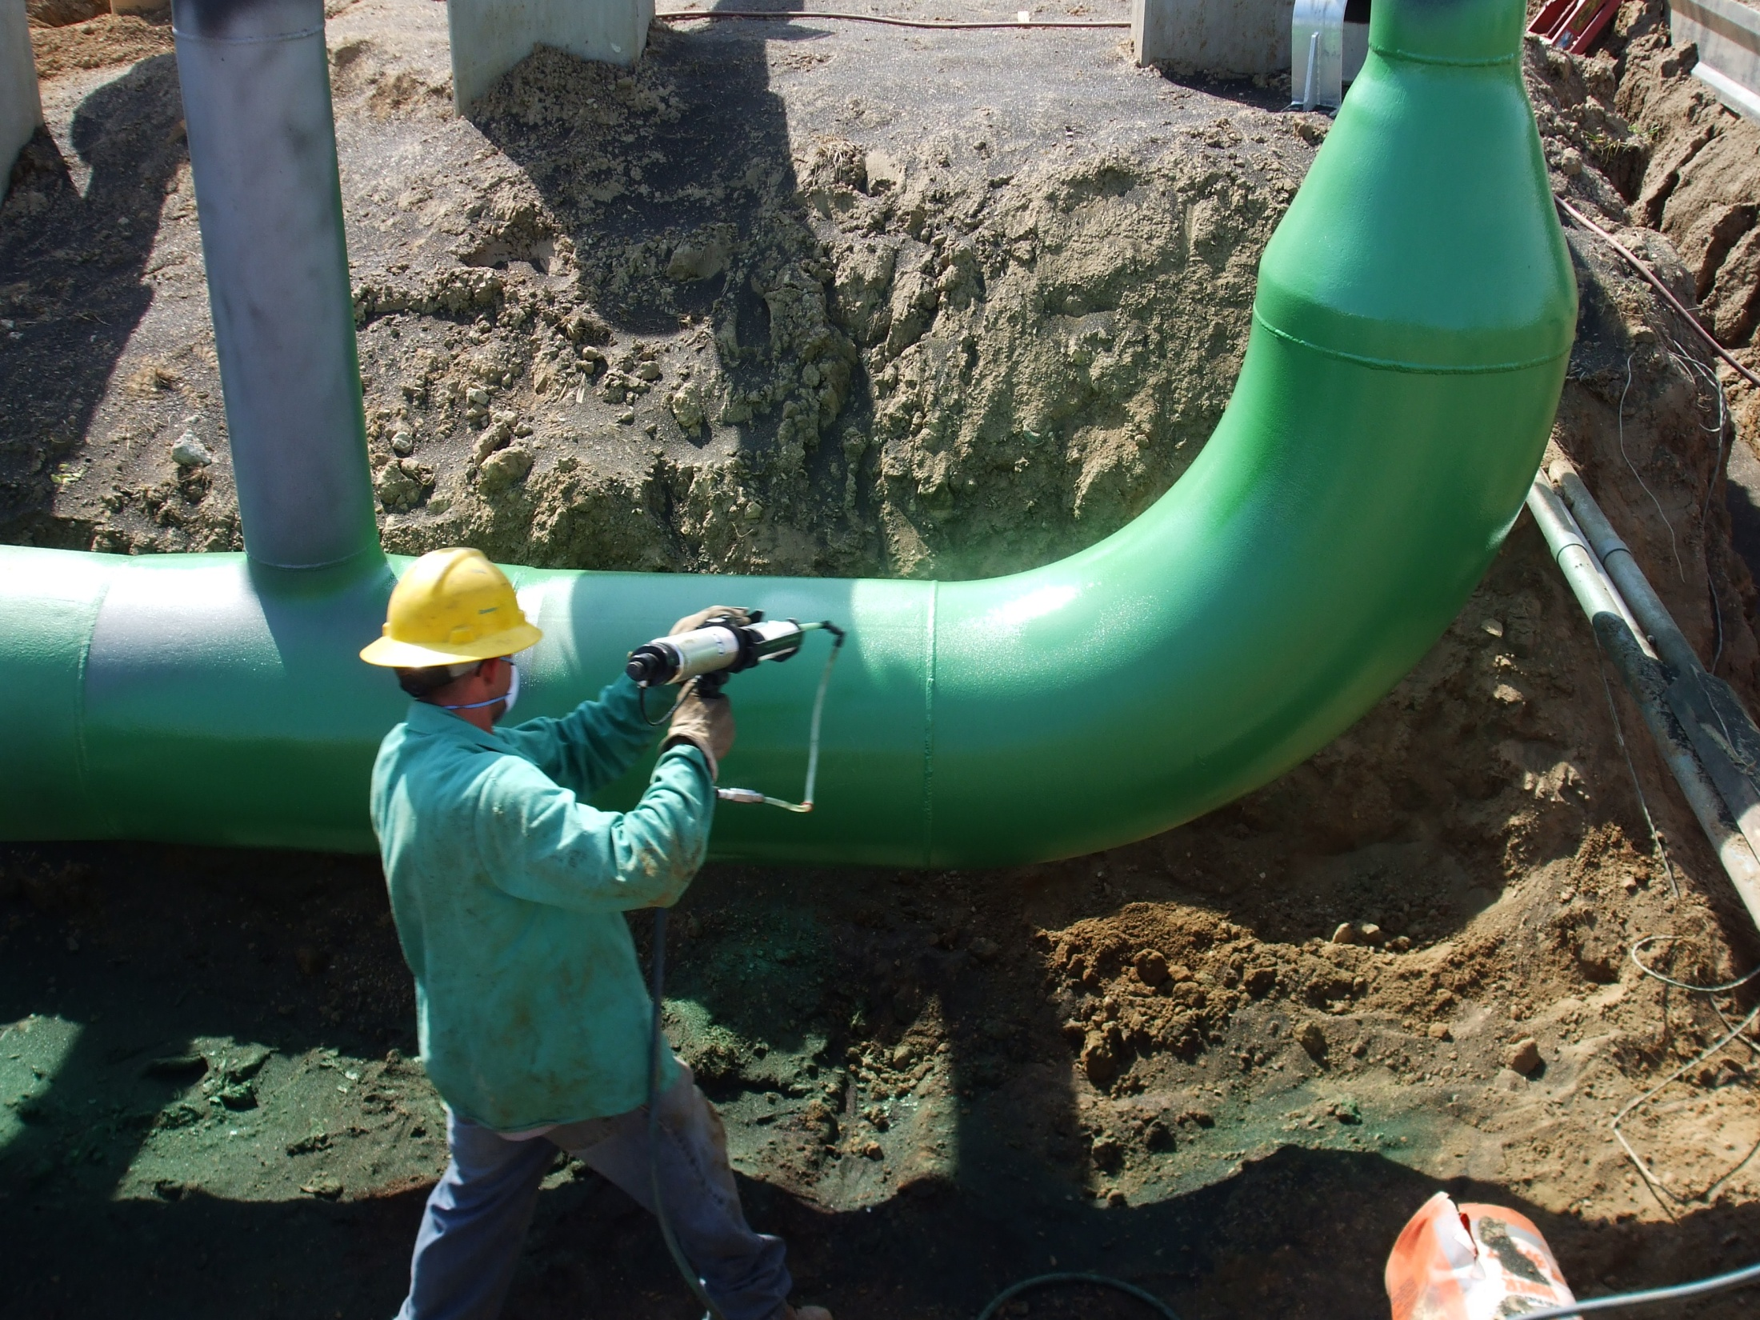

Slide 36
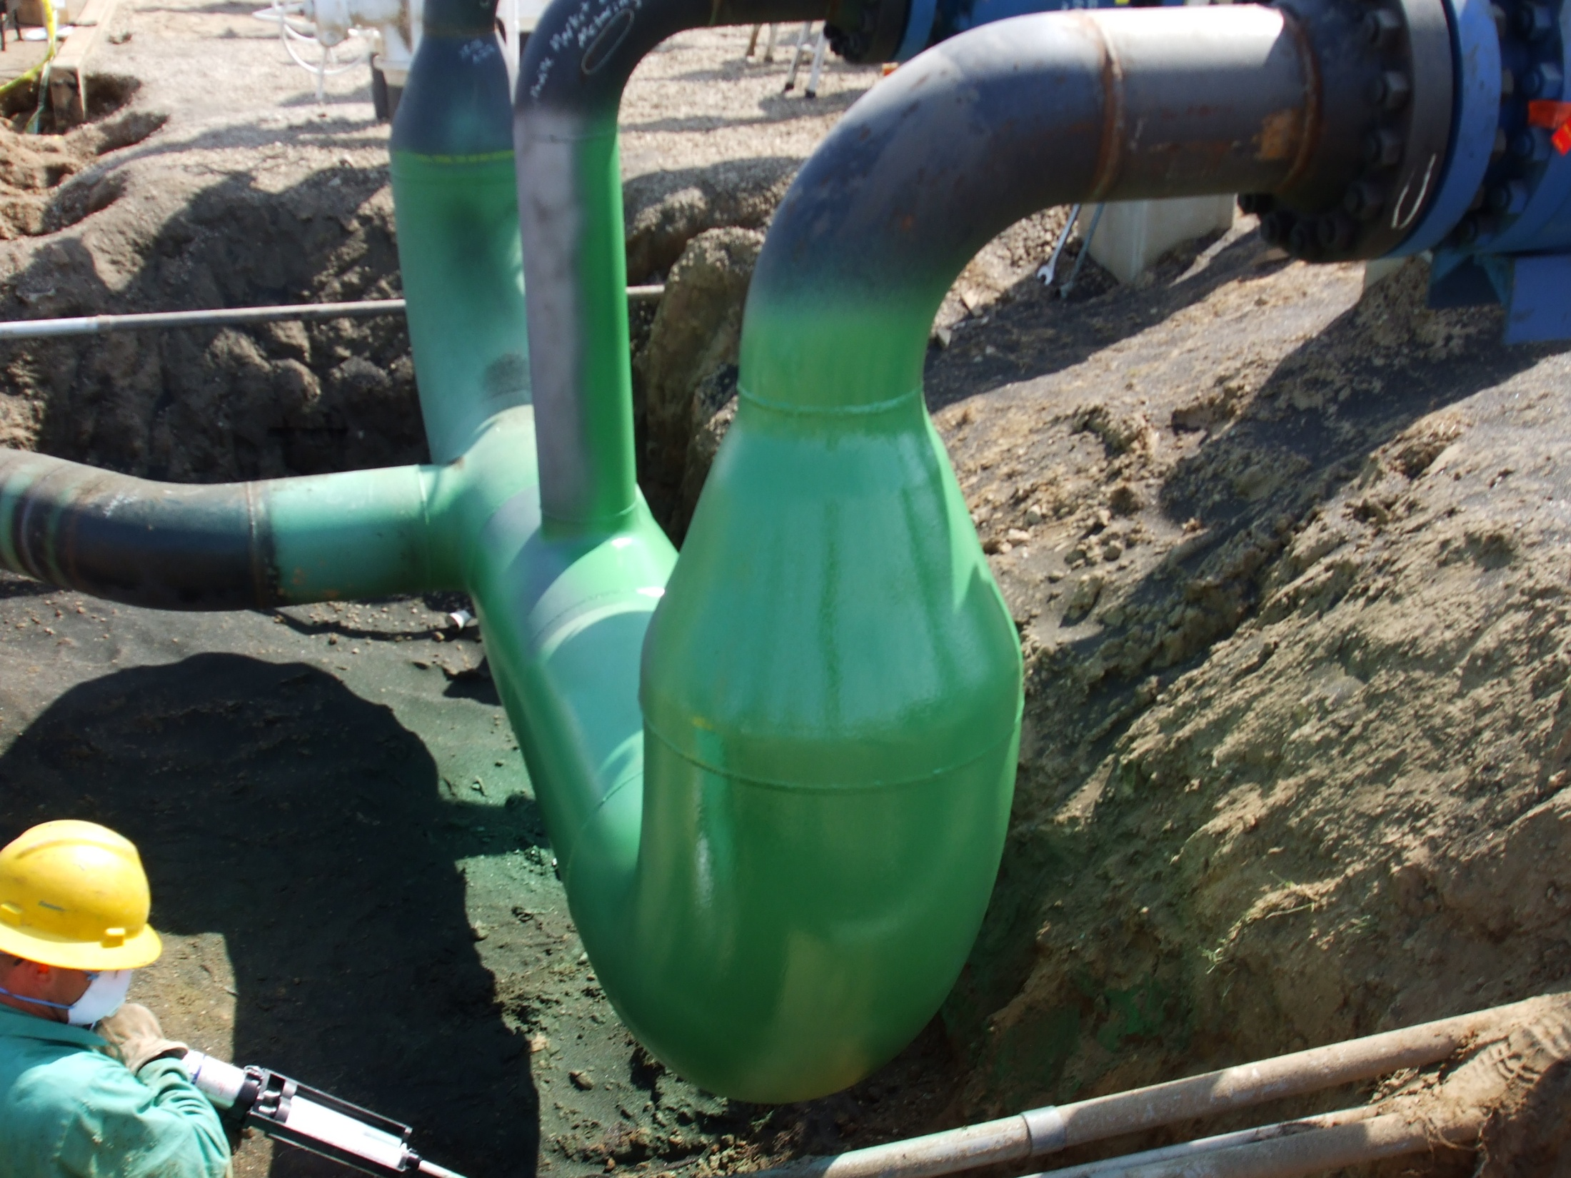

Slide 37
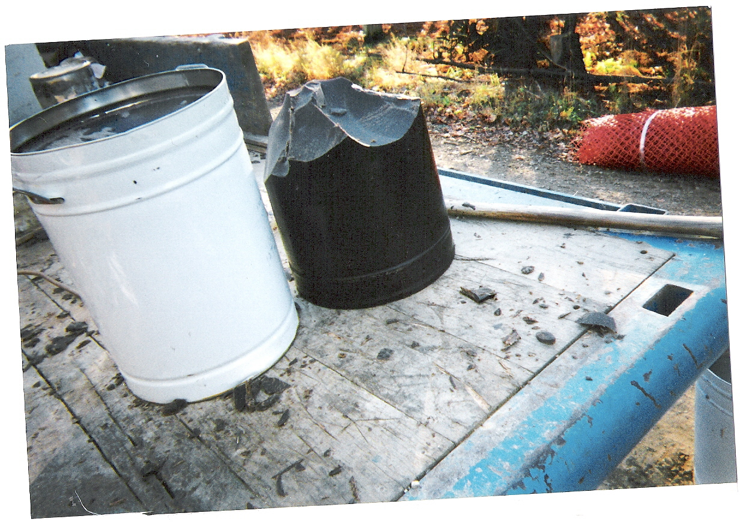

Slide 38
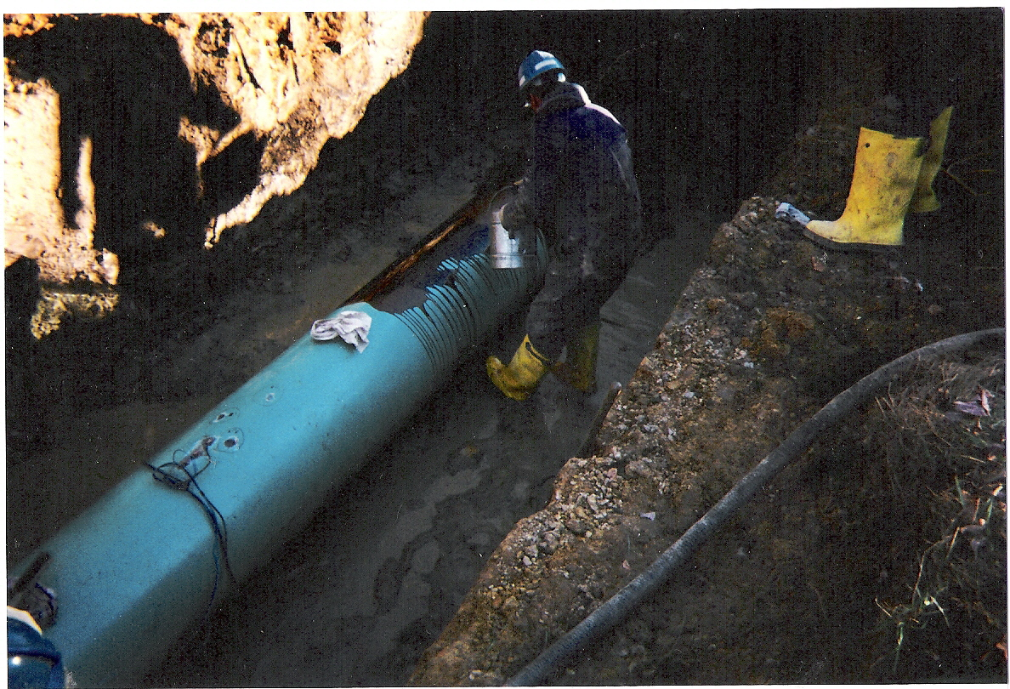

Slide 39
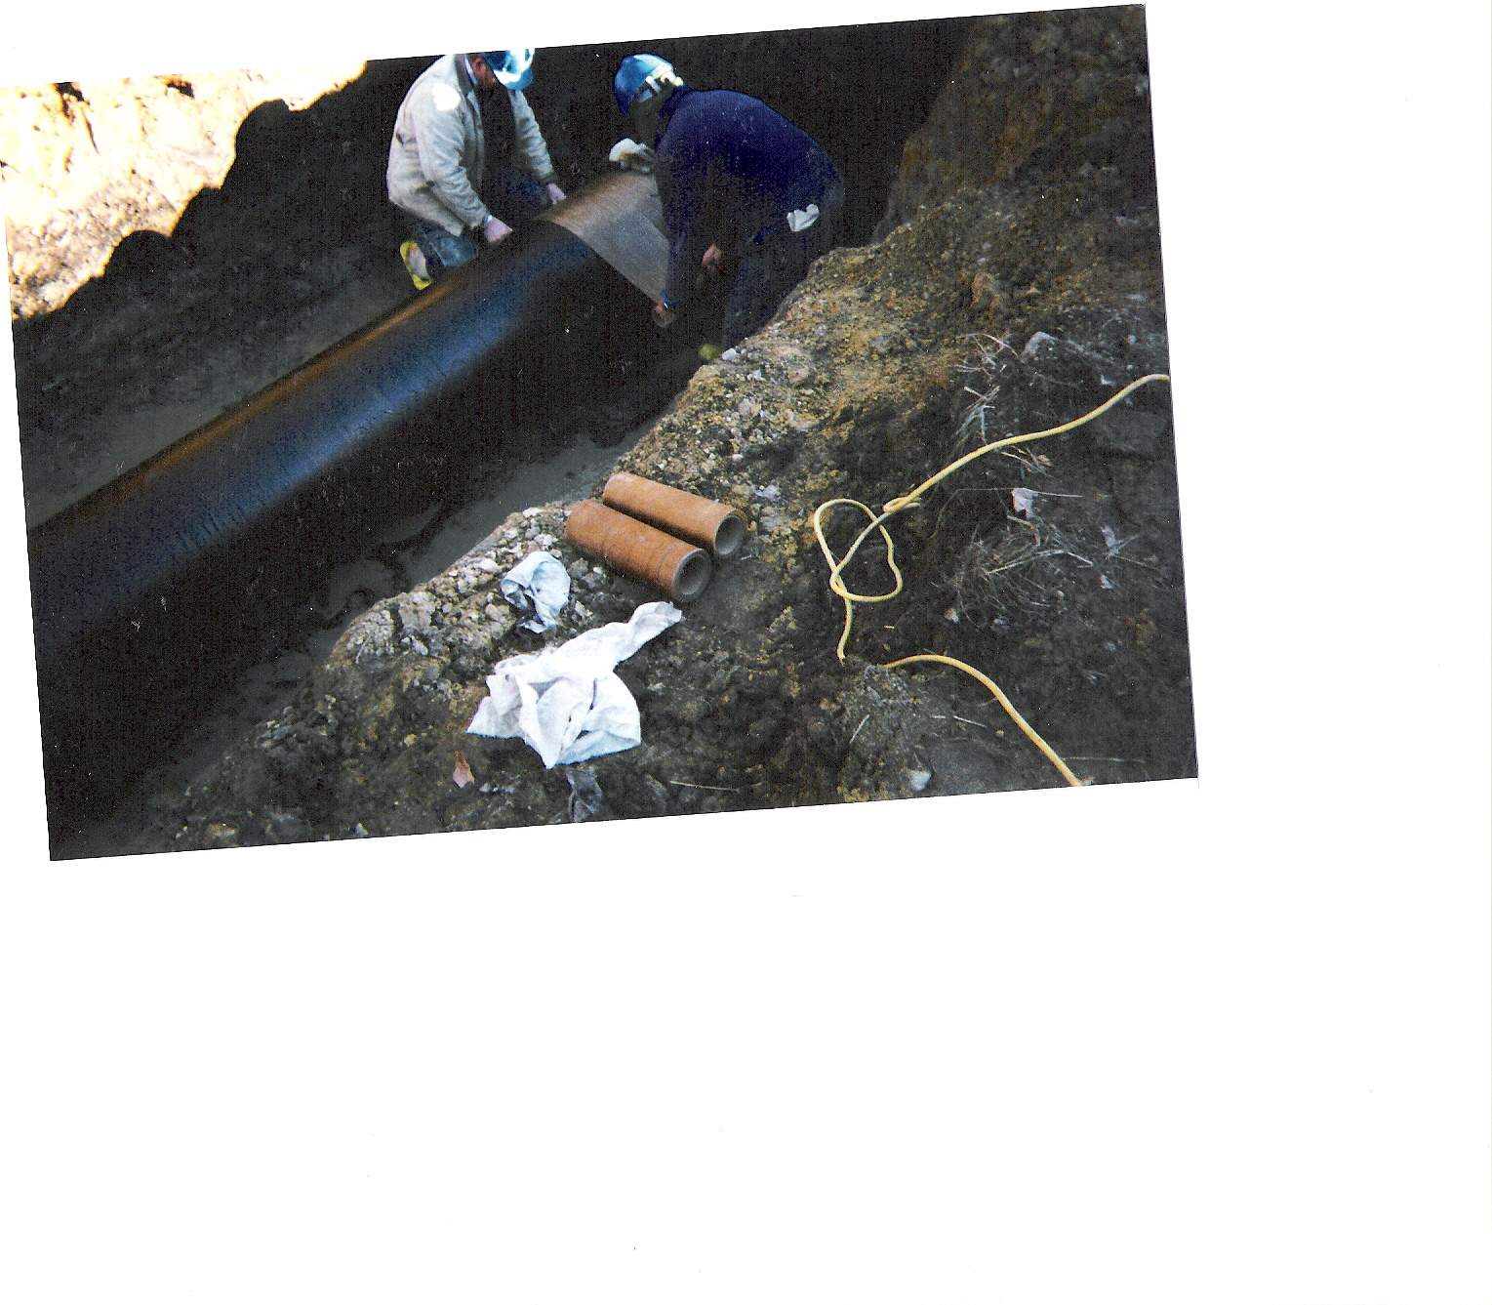

Slide 40
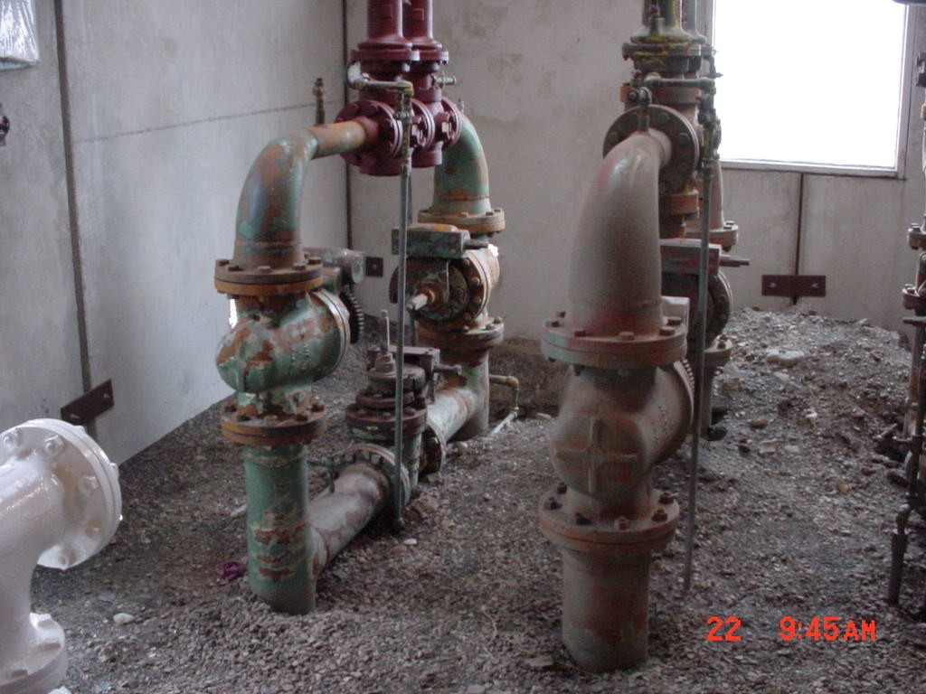
Settings cleaned and ready for coating application

Slide 41
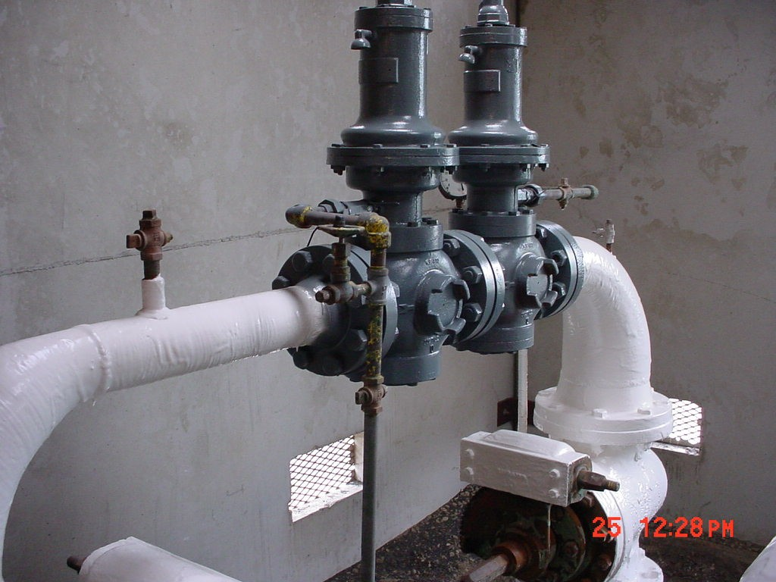
First application of Epoxy Coating and Enamel Paint
All regulator bodies and bolts coated with enamel paint

Slide 42
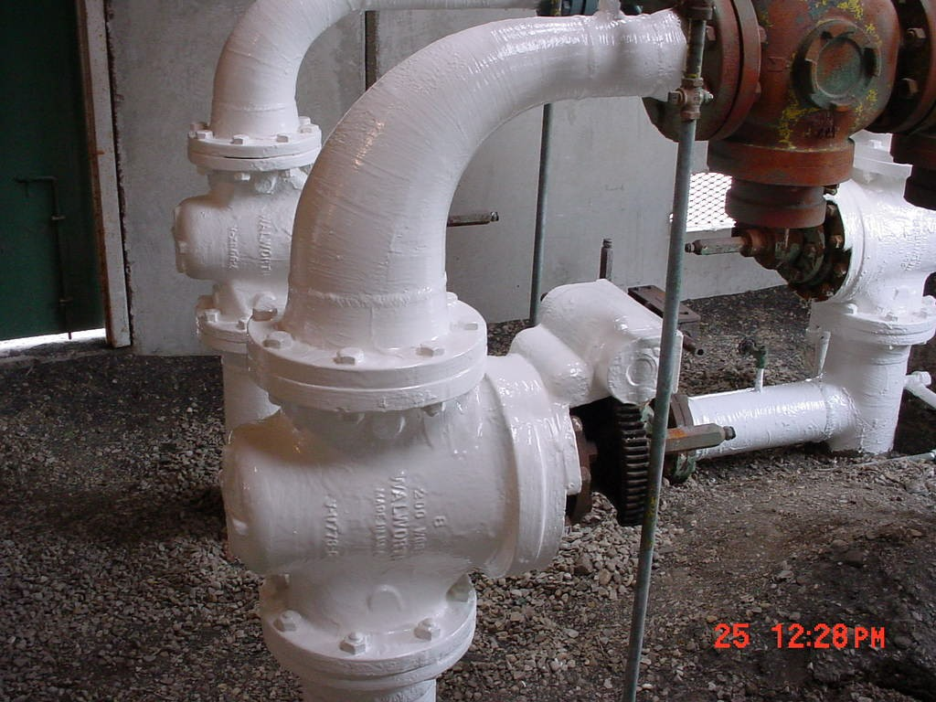
All moveable parts coated with enamel paints

Slide 43
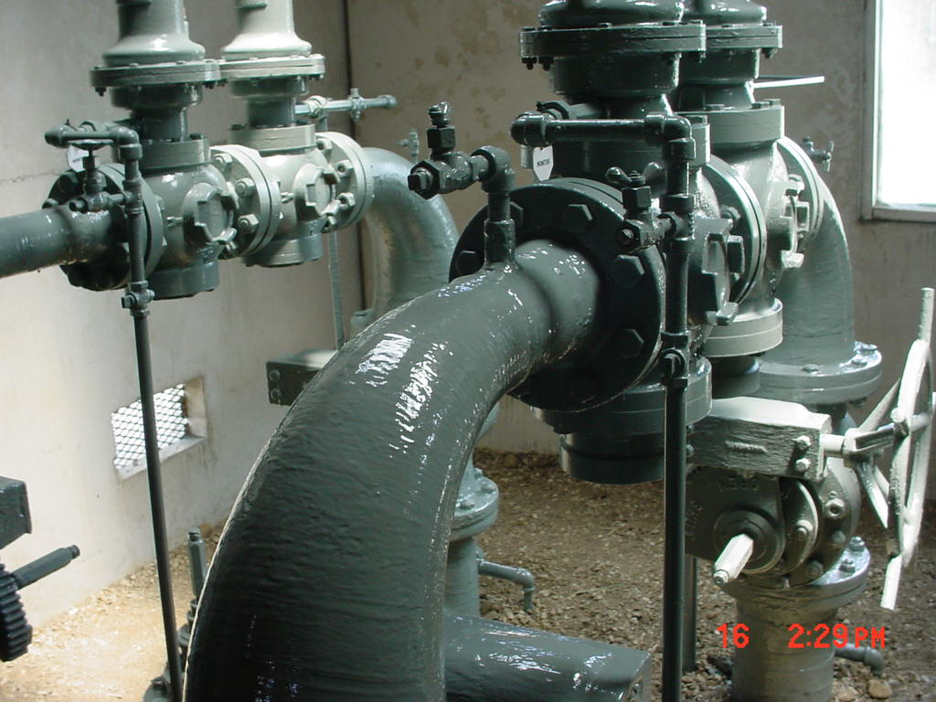

Slide 44
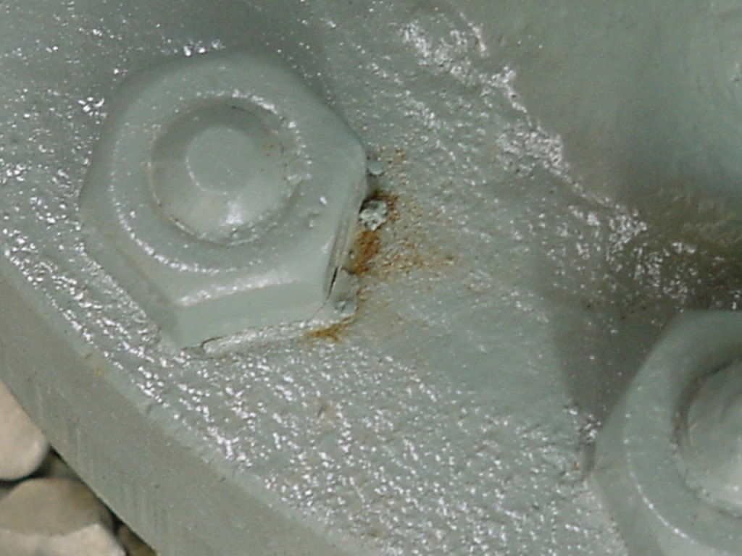
Maintenance on Settings
Damaged area

Slide 45
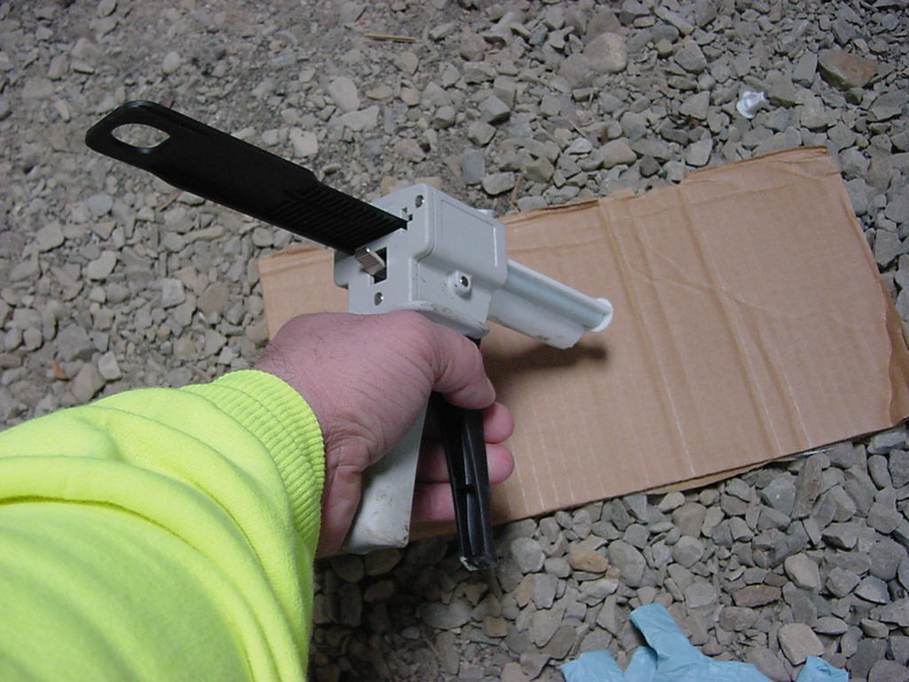
Maintenance on Settings
Use a piece of Cardboard for mixing procedure

Slide 46
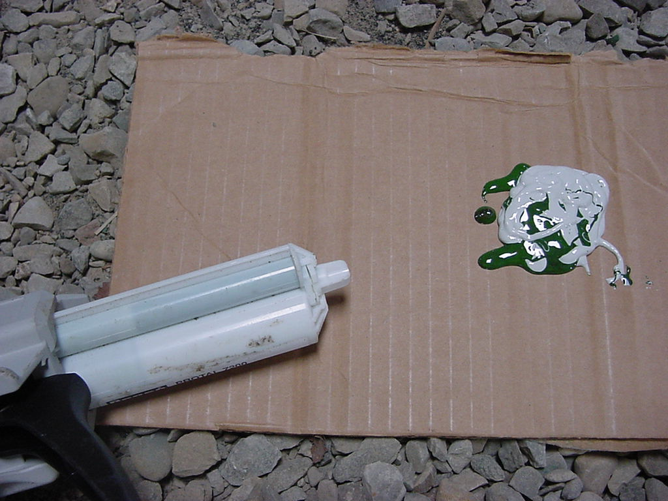
Maintenance on Settings
3 to 1 ratio
Clean tip after each use to prevent clogging
Smallest Tube contains the hardener
The larger Tube contains the Epoxy Resin

Slide 47
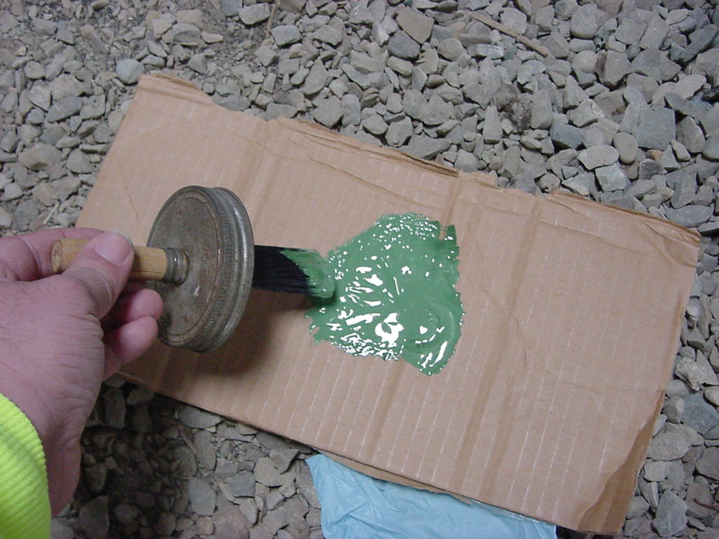
Maintenance on Settings
Mix until a solid color is obtained

Slide 48
Maintenance on Settings
Surface preparation – hand tool cleaning
Apply Epoxy

Slide 49
Before
After

Slide 50
Apply Void Filler

Slide 52
Valves and Flanges
Profile Mastic is applied around the bolts, crevice and crack areas to block moisture or water from entering.

Slide 53
Valves and Flanges
The petrolatum wax tape is used over the profile mastic.

Slide 54
The valve side view of being exposed to the outside atmosphere.

Slide 55
Side view of the valve after blasting corrosive and coating disbondment areas.

Slide 56
The valve at a side view, finished.

