Slide 1
Soil Corrosivity and Corrosion Control
Dr. Zamanzadeh (Zee)
Geoff Rhodes
Matco Services, Inc.
October 8th, 2009

Slide 2
Outline
1: Introduction
2: Soil Characteristics
3: Soil Corrosivity
4: Parameters effect soil corrosivity
5: Soil corrosion rate
6: Corrosion Inspection
7: Corrosion Control
8: Cathodic Protection
9: Q & A
Notes:
2

Slide 3
History
1-Early Century: all corrosion problems was attributed to stray currents from trollly cars, and subways.
2-1910 congress authorized NBS(National Bureau of Standards to investigate stray current problems
3-By 1920 they found out that you do not need to have stray currents to have corrosion problems
4-1945 NBS concluded that soil corrosion is too complex to permit correlation with any one parameter. Extensive data was provided at this time for many soil conditions and metals

Slide 4
Predicting Soil Corrosivity
Natural Resources Conservation Service
1974 extensive soil testing performed on over 2,300 soil types in United States
Soils described by horizon (layer), structure, color, organic content, pH, water table, topography, and chemical/mineral content.
Websoilsurvey.nrcs.usda.gov/app/websoilsurvey.aspx

Slide 5
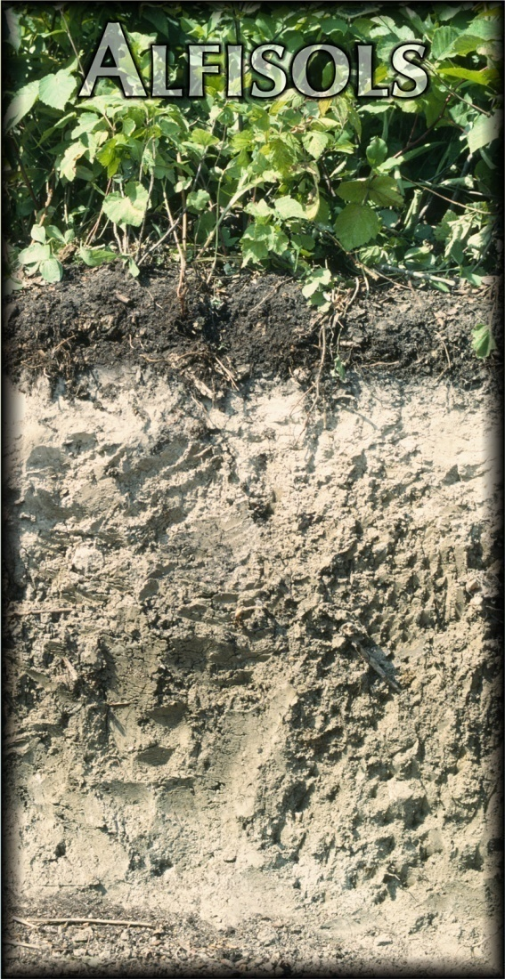
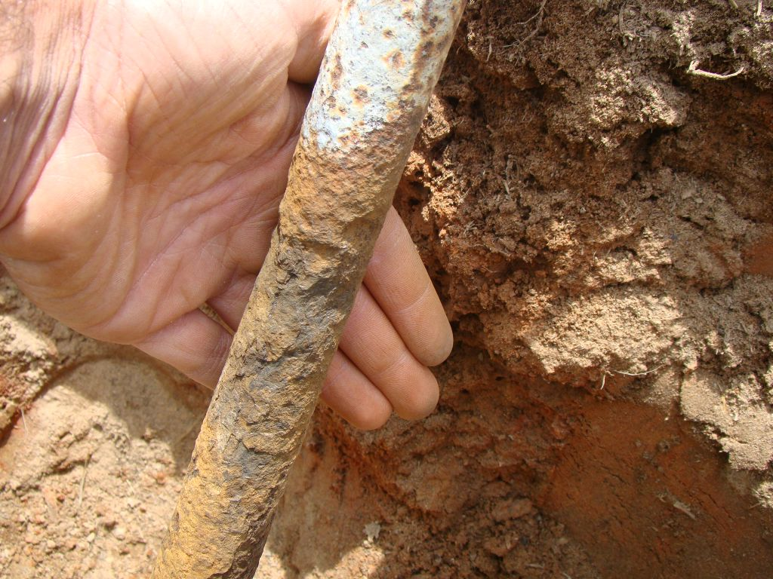
Predicting Corrosivity of Soils
Utility Towers, Poles, Water Mains, Anchor Rods, Copper Grounding…

Slide 6
Why Do We Need to Predict Soil Corrosivity?
Early corrosion prevention
Specify coatings, cathodic protection, or alternate materials
Specify inspection and maintenance intervals for buried structures and utilities

Slide 7
What are the main components of soil?
Mineral Matter
Air
Water
Organic Matter
Is the soil passivating ?
Corrosive Ions?

Slide 8
Soil Chemistry
1- Mineral soils are a group of primarily inert
combinations of oxygen, aluminum, silicon, and
iron (and other metals).
2- The primary constituents of over 80% of soils are:
  – Poly silicates: (Si₃O₈⁴⁻) + K, Al, or Na
  – Orthosilicates: (SiO₄⁴⁻) + K,H,AL,Ca, Fe, or O
  – Metasilictes: (SiO₃²⁻) + Ca, Mg, ….
  – Oxides: (SiO₂, Fe₂O₃, Fe₃O₄)
  – Calcite: (CaCO₃)
  – Hydrous Aluminum Silicates (Clays): (Al_{x}O H_{y}) (Si_{x}O_{y})
3- Organic matter is another constituent
4- Corrosive Ionics: Chlorides, Sulfates, Sulfides

Slide 9
What Factors Affect Soil Corrosivity?
– Chloride level
– Moisture content
– Oxygen content/Redox potential
– Soil permeability/texture
– pH/Acidity
– Temperature
– Soil resistivity
– Drainage characteristics
– Sulfate and Sulfite ion concentrations
– Microbiological activity
– Stray currents, Electrochemical Potential Fields
– Spillage of corrosive substance/pollution
- Agricultural chemical activities

Slide 10
Soil Testing – Soil Classification
Classification per ASTM D2487 & D2488
  Soil structure:
    Gravel (Coarse particles – retained on #4 sieve)
    Sand (Coarse particles – retained on #200 sieve)
    Silt & Clay (Fine particles – passing #200 sieve)
  Color
    Stark color changes indicate reducing soils
    Dark colors indicate organic matter
    Light colors indicate mineral leaching

Slide 11
Soil Testing – Soil Classification
  Odor
    Organic smells may indicate biological activity
    Sulfurous smell may indicate microbiological activity – particularly anaerobic bacterial activity
  Plasticity
    High to moderate plasticity indicates high water holding capacity
    Low plasticity indicates poor water holding capacity

Slide 12
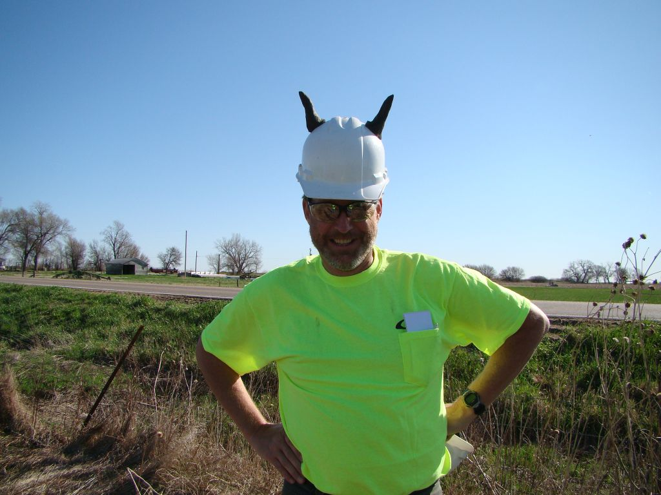
Soil Testing – Soil Classification
Structure: Clay + silt
Color: Homogenous, dark brown
Odor: Slightly organic
Plasticity: High
Corrosivity: Moderate to low depending on ion content & pH later found to have neutral pH and low chloride content; low corrosivity

Slide 13
Soil Characteristics (clay and sand)
1- Clay has the finest particle size which reduces movement of air
(oxygen) and water, i.e. low aeration when wet. This may lead to
very low general corrosion, but increase local (pitting) corrosion by
setting up differential aeration cells.
2- However the high plasticity (stickiness) of clay during shrink-swell
of the soil can pull off susceptible coatings.
3-Clay also is susceptible to cracking during wet-dry cycling which
can help transport air and moisture down to the pipe surface.
4-Sand promotes aeration and moisture distribution. Soluble salts
and gases (air/oxygen) can are more easily transported to the
metal surface. This may lead to greater general corrosion but also
produce less pitting.

Slide 14
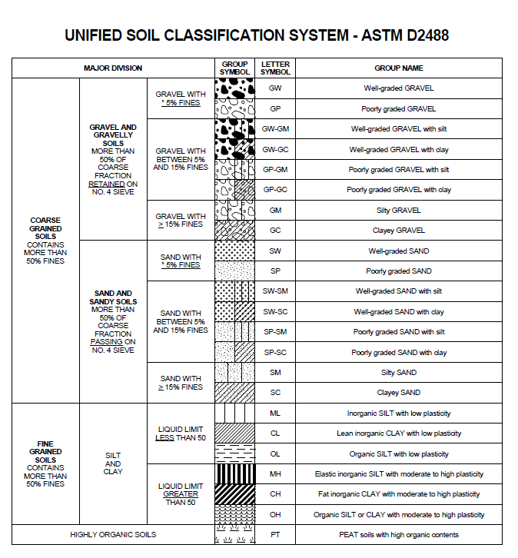
Soil Classification per USCS

Slide 15
Soil Testing
Soil Resistivity Testing:
  In-Situ Soil Resistivity – 4-Pin Wenner Method
  Laboratory Minimum Soil Resistivity
Water-Soluble Chloride Testing
Water-Soluble Sulfate Testing

Slide 16
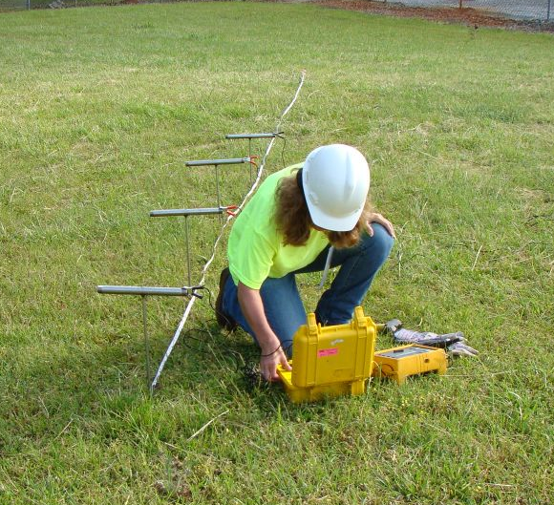
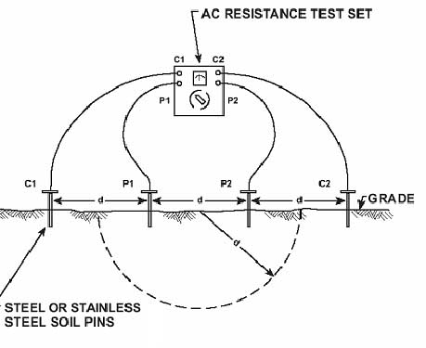
Soil Testing
In-Situ Soil Resistivity Testing

Slide 17
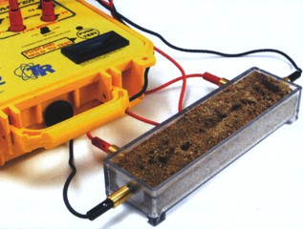
Soil Testing
Laboratory Minimum Soil Resistivity Testing
<500 ohm-cm Extremely corrosive
500-1,000 ohm-cm Very corrosive
1,000-2,000 ohm-cm Moderately Corrosive
2,000-10,000 ohm-cm Mildly Corrosive
>10,000 ohm-cm Progressively lower corrosivity

Slide 18
Color and Aeration
High levels of bacteria can consume the oxygen present in the soil
  Bacteria ➔ Consume O₂ ➔Poor Aerated
Hot-dip galvanized steel will not perform as well in soils containing large amounts of organic bacteria
18
Notes:
18

Slide 19
Time of Wetness
Time of wetness affects the corrosion rate of a soil.
The longer soils stays wet the more corrosive the soil is to HDG steel.
Frequent rainfall promotes more acidic soil conditions and increases time of wetness, both increasing the corrosivity of the soil.
19
Notes:
19

Slide 20
Particle Size
Controls aeration and time of wetness
  3 categories of particle size for soils
Sand (0.07 - 2 mm )
Silt (0.005 - 0.07 mm)
Clay (< 0.005 mm)
20
Notes:
20

Slide 21
Color and Aeration
Simplest method of characterization
  Red, Yellow and Brown ➔ Oxidized Fe
  ➔ Well Aerated
  Well aerated soils are less corrosive than poorly aerated soils for HDG
  Gray ➔ Poorly Aerated ➔ More Corrosive
21
Notes:
21

Slide 22
Questions to be asked
Does corrosion take place?
If it does, how fast? Life expectancy?
How can we control the rate of corrosion?
Notes:
22

Slide 23
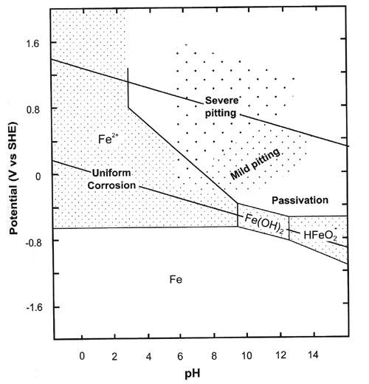
Stability Diagram For Iron
Corrosion
Immunity, Cathodic Protection
Notes:
23

Slide 24
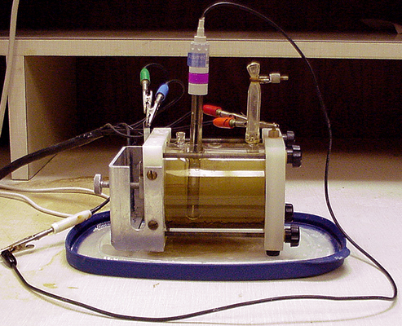
Soil Testing – Electrochemical
Linear resistance polarization – Directly measures corrosion rate and identifies oxidizing or reducing nature.
Zero-resistance ametry – Measures susceptibility to galvanic corrosion.

Slide 25
Corrosion Rate
Test coupon
Resistance Polarization
Tafel Law
Dynamic Polarization
EIS
Physical Measurements

Slide 26
Failure Examples

Slide 27
Utility, Communication Tower Structures
Anchor Rods
Galvanized Poles and Towers
Copper Grounding

Slide 28
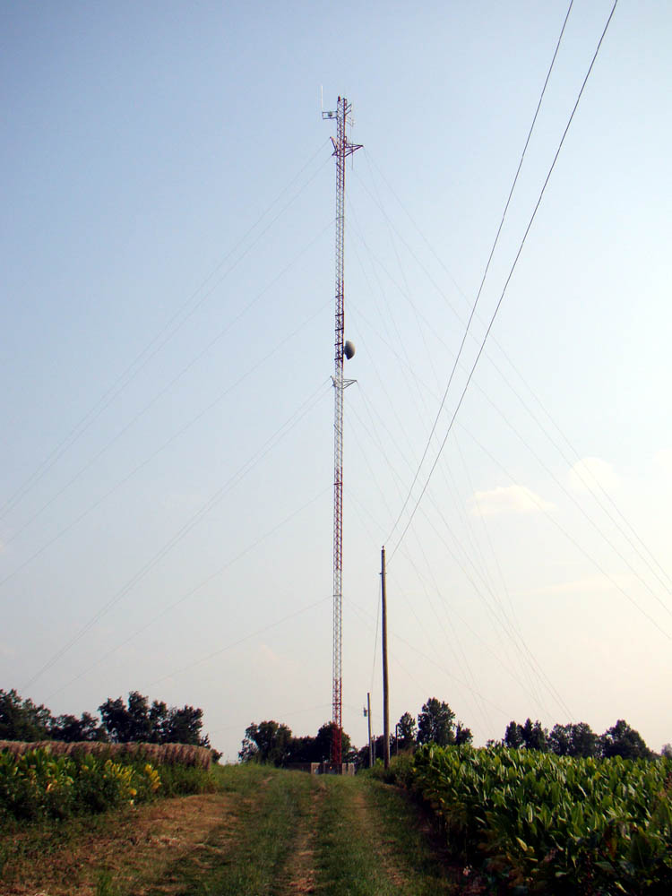

Slide 29
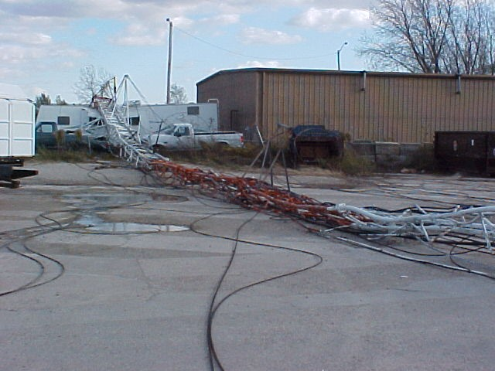

Slide 30
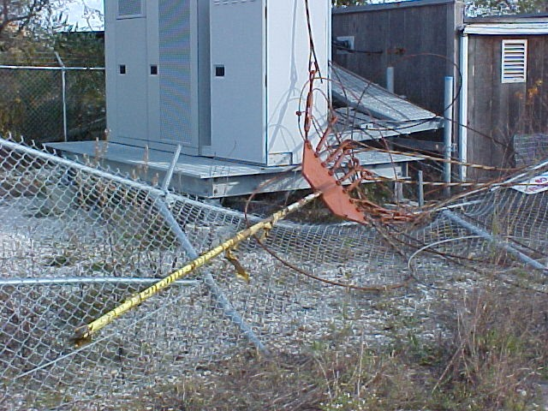

Slide 31
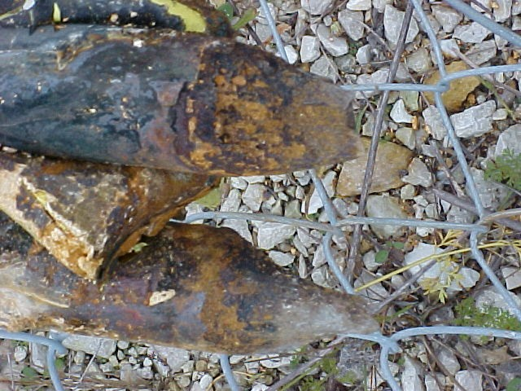

Slide 32
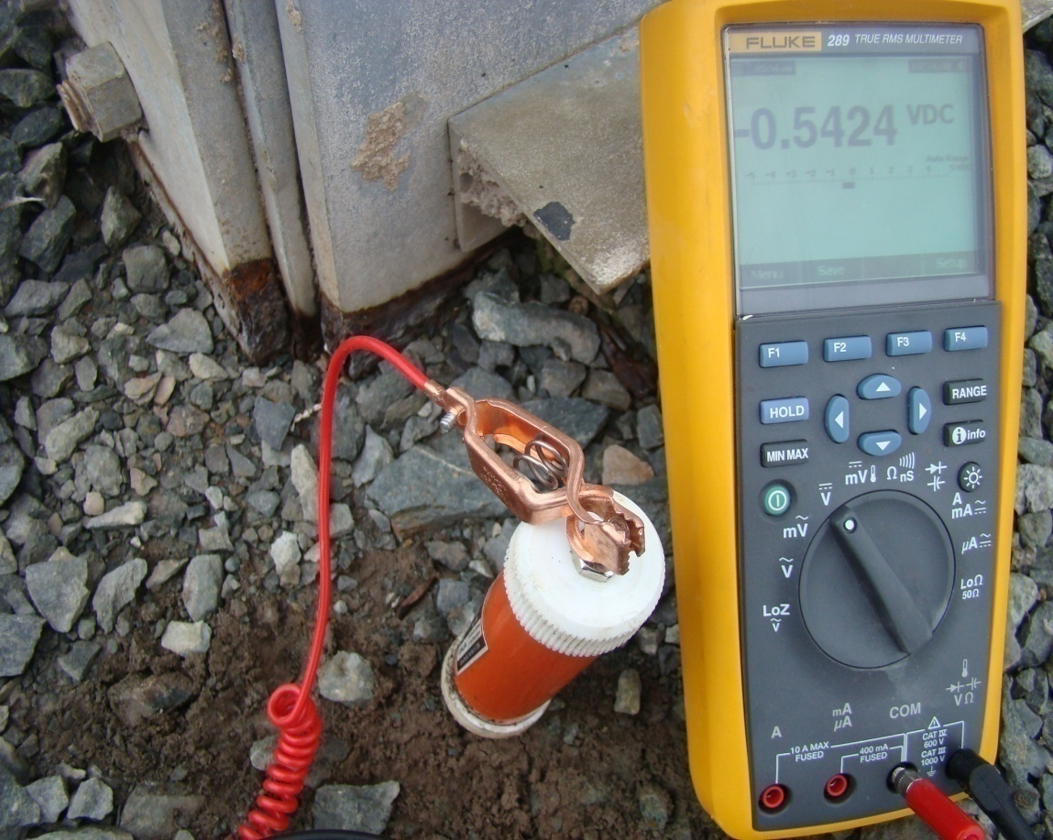
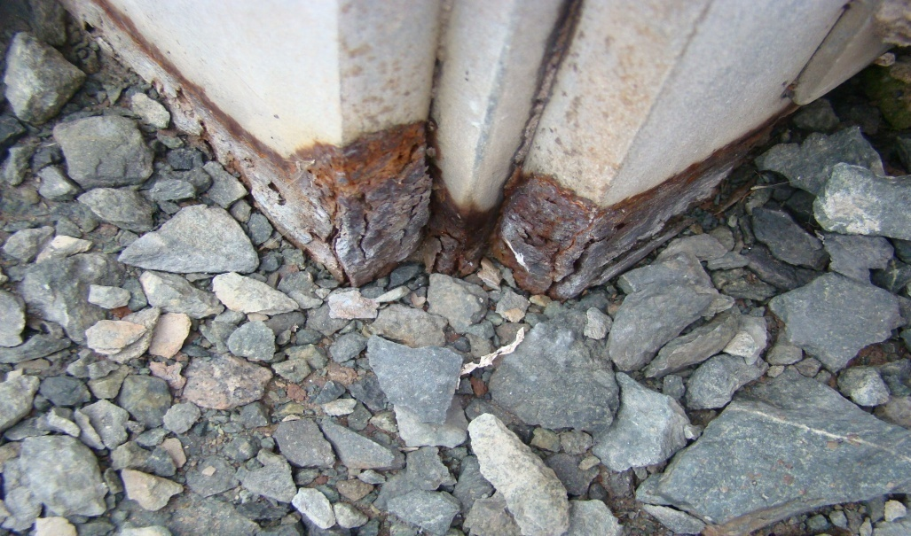

Slide 33
CASE
HISTORY
Graphitization:
Cast Iron Water Main
Brittle Failure
Notes:
33

Slide 34
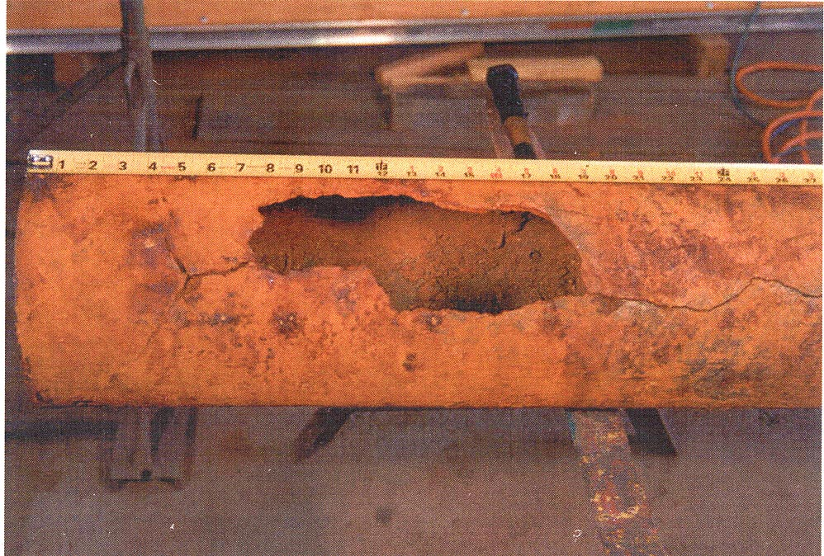
Photograph showing the longitudinal crack in the pipe.
Notes:
34

Slide 35
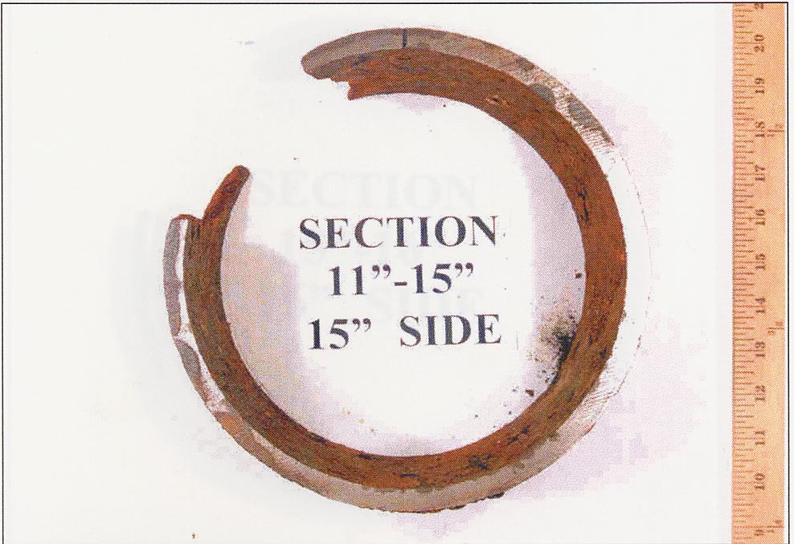
Photograph showing the transverse saw cut through the pipe at a location 15 inches from the end of the pipe
Corrosive soils, Clay, High Salt Content Soils and MIC low pH
Notes:
35

Slide 36
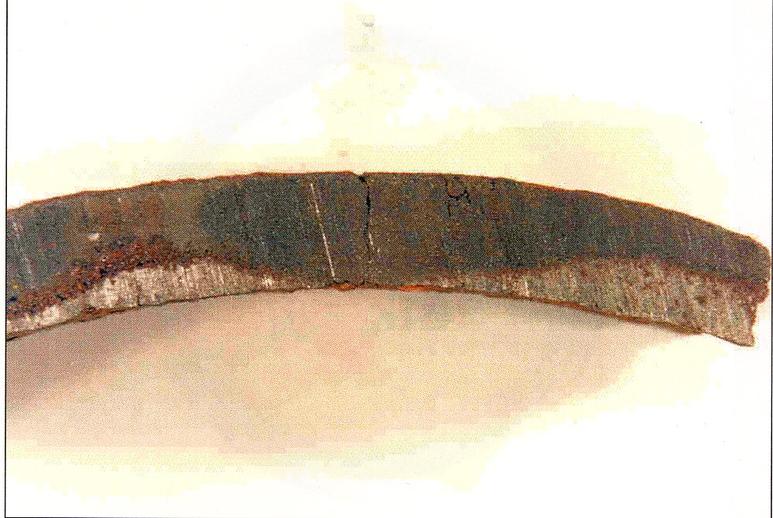
Photograph showing that secondary cracking was confined to the corroded areas of the pipe.
Notes:
36

Slide 37
More Failures
Failure of Towers in flooded valley, 2001
Similar incident in BC 2002
Failure of anchor rods 2003
Failure of anchor rods 2005
High chloride content & low pH
Very high chloride content & high pH

Slide 38
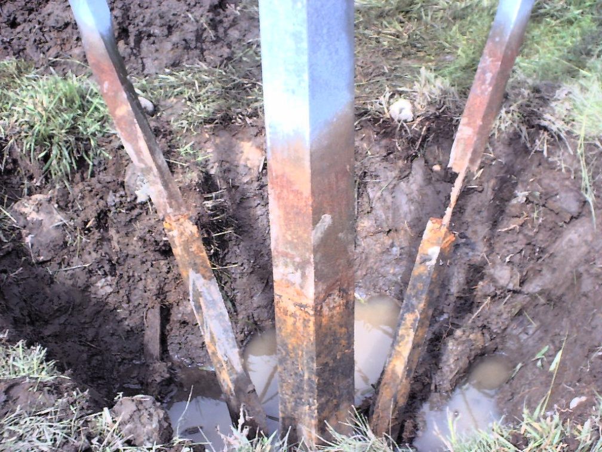
Direct Burial Utility Towers
Localized Corrosion Attack at a load bearing member
Notes:
38

Slide 39
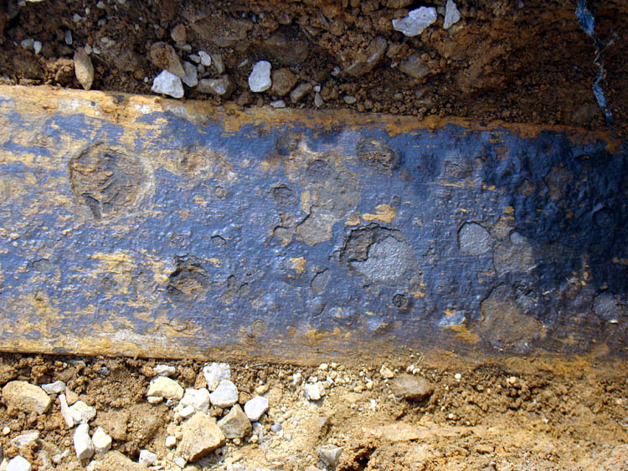
Extensive Localized Corrosion
Suspect Potentials
Notes:
39

Slide 40
Galvanized Anchor Rod
Above Ground
Underground
Copper Grounding
Soil Environment
Water Table
Age
Coating
Cathodic Protection
Life Expectancy

Slide 41
Corrosion
Galvanized Anchor Rods
Failure
Corrosion

Slide 42
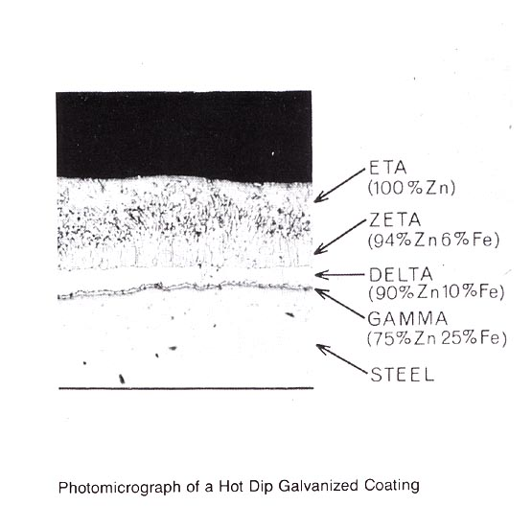
Galvanized Steel
Shiny vs. Dull

Slide 43
Galvanized Steel
Fundamental Mechanisms
Barrier
Cathodic Protection

Slide 44
Methods of Protecting Iron and Steel
Barrier Protection
  Isolates metal from the environment
  Must adhere to the base metal
  Must be resistant to abrasion
Cathodic Protection
  Change electrochemistry of corrosion cell
  Based on the electrochemical series
  Insure base metal is the cathodic element

Slide 45
Stability of Galvanized Steel
Oxygen, Water, Corrosive ions
Thickness
Corrosion Rate

Slide 46
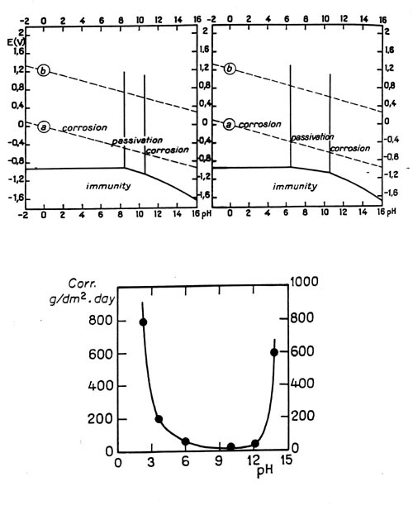
Thermodynamics
Stability
Zinc (galvanized)

Slide 47
Example:
INSPECTION of Tower Ground Anchors

Slide 48
Objectives of Inspections
Ensure inherent structural integrity and safety
Determine corrosion rate and life expectancy
Forecast and plan maintenance
Extend life of the system
Achieve safety, structural integrity, and service life at minimum cost

Slide 49
Inspection Techniques
Visual
Excavation and Visual Inspection
Non-destructive techniques(sound, EM…)
Electrochemical Techniques
Desk Study
Tier Testing Inspection
Frequency of Inspection

Slide 50
Excavations--Should I Dig(2ft)?
Common Industry Practice
Negative Factors
  Labor intensive
  Inherently damaging
  Inadequate visual examination
  Safety compromised during fill removal
  Trenching regulations
  Difficult to repeat

Slide 51
Anchor Rod Corrosion Scenarios
Corrosive Soil or Backfill
Galvanic effects
Stray Currents
Notes:
51

Slide 52
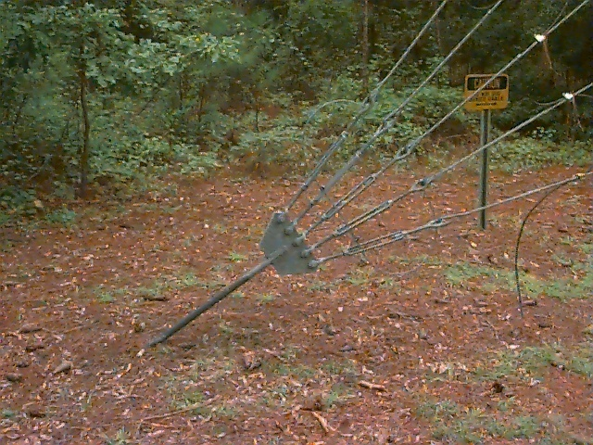

Slide 53
Corrosion of Anchor Rods
Determine presence of active corrosion: High risk areas
Determine approximate corrosion rate
Specific recommendation:
  a) Immediate action:1 to 3- 5 to10 years
b) No action, Cathodic Protection & Coating,

Slide 54
Knowledge Based Inspection
A knowledge based assessment plan is critical to an effective and affordable asset management program.
Knowledge Based Inspection can identify the most critical component(s) based on operating stresses and corrosion mechanism (s)
To ensure that they are maintained at a condition above the critical threshold
Notes:
54

Slide 55
Benefits of Knowledge Based Inspection
By eliminating inspection tasks that contribute little to risk management and mitigation
Defines current condition
Deterioration rate
Performance requirements
Reliability thresholds
Notes:
55

Slide 56
Inspection
Photographic documentation
Potential measurements
Selection of anchor rod
Photographic documentation
Potential mapping
Soil resistivity measurements 3 depths
General Observations: Grounding issues, corrosion observations, paint problems, site problems, mechanical damage, concrete problems and corrosion in concrete
Excavation
Dimension & coating measurement
Soil testing: dry and wet, corrosion rate, ZRA….
Computerized data entry
Review by team leader, Matco project manager and Dr. Zee
Recommendations: Repair, Replacement or no action. Cathodic Protection

Slide 57
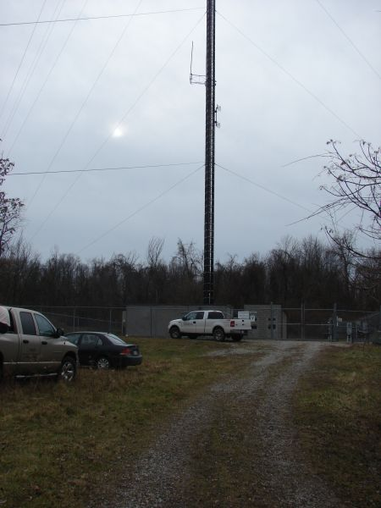
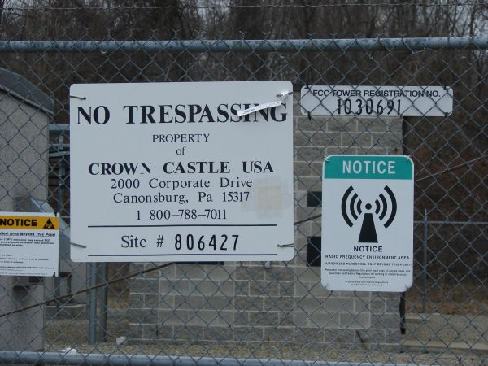
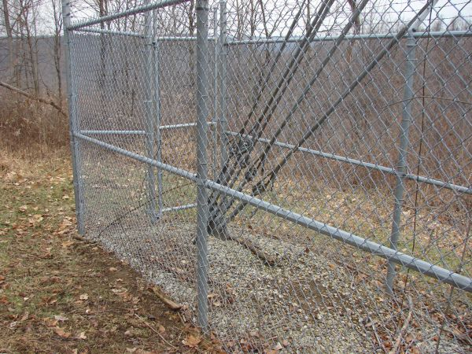
Photographic Documentation

Slide 58
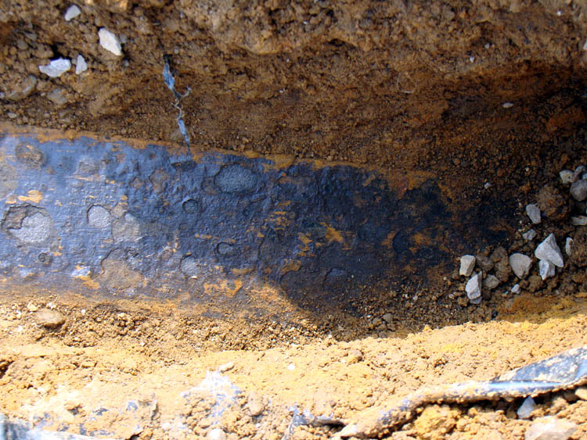
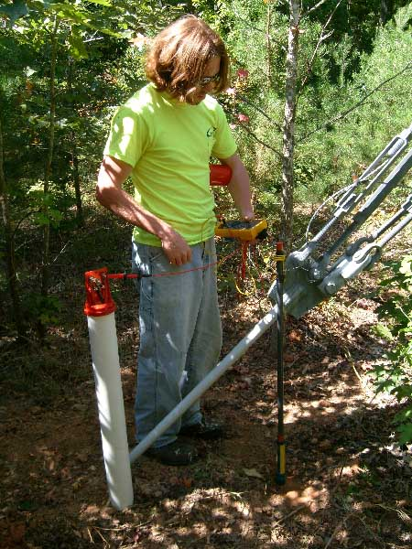
Electrochemical Measurements
Structure-to-soil potential measurements at anchor.
Single Electrode Survey will indicate localized cathodic or anodic areas along the anchor.

Slide 59
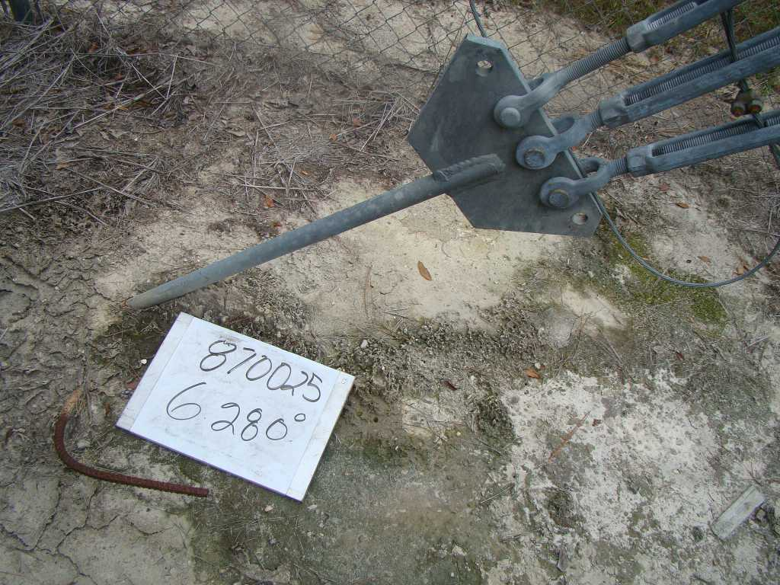

Slide 60
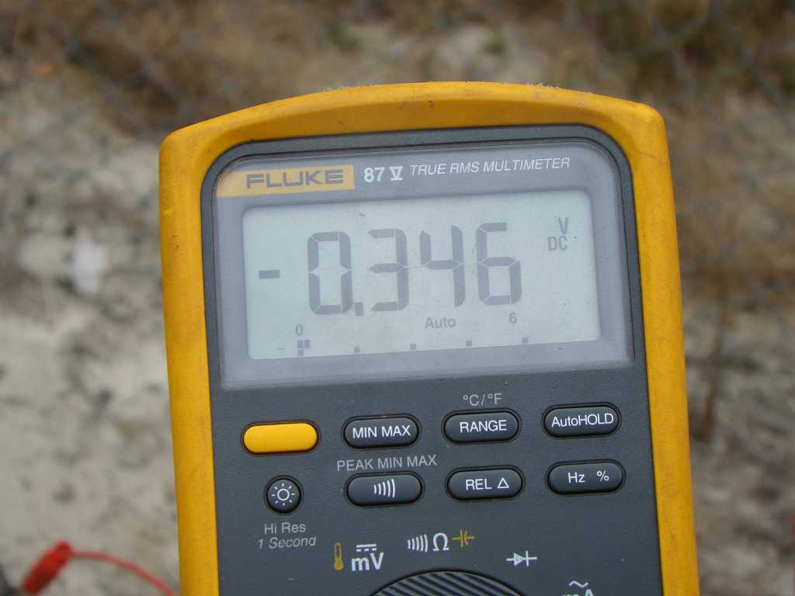
BU # 872005

Slide 61
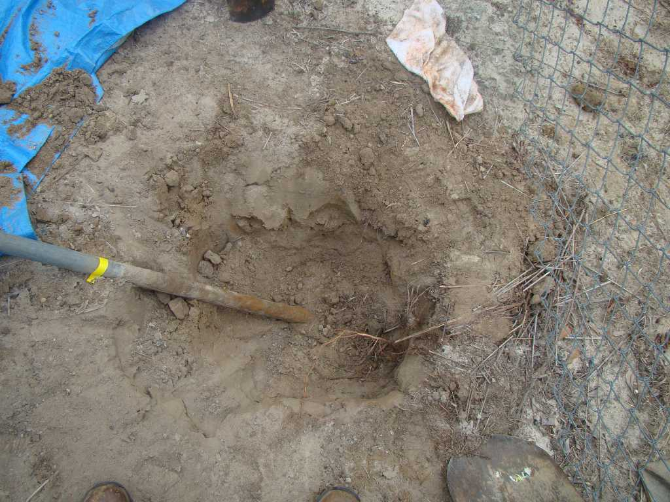

Slide 62
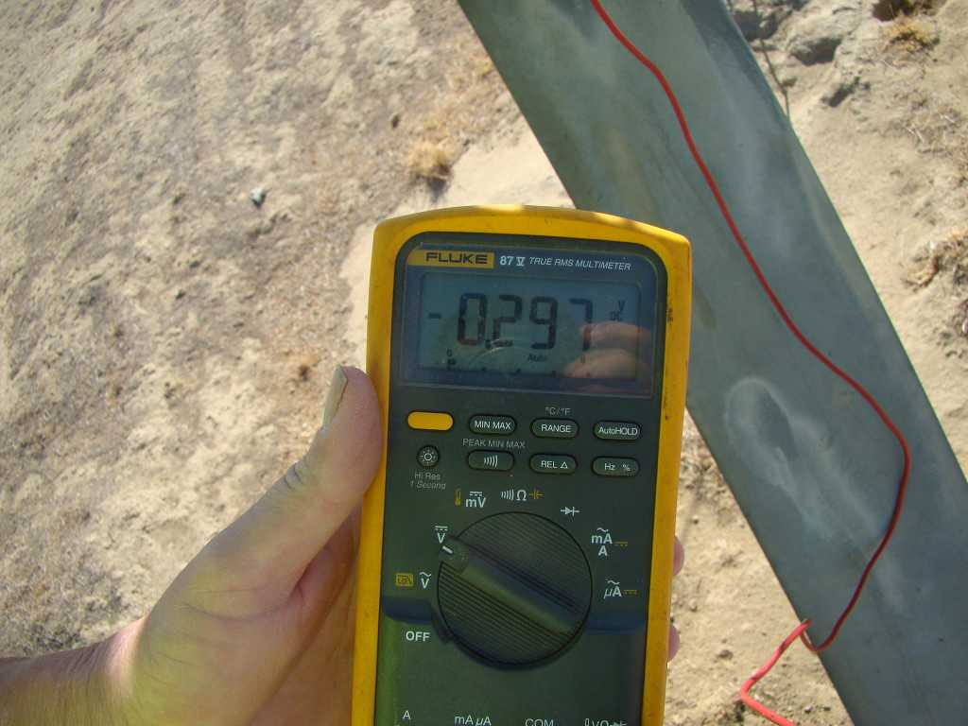

Slide 63
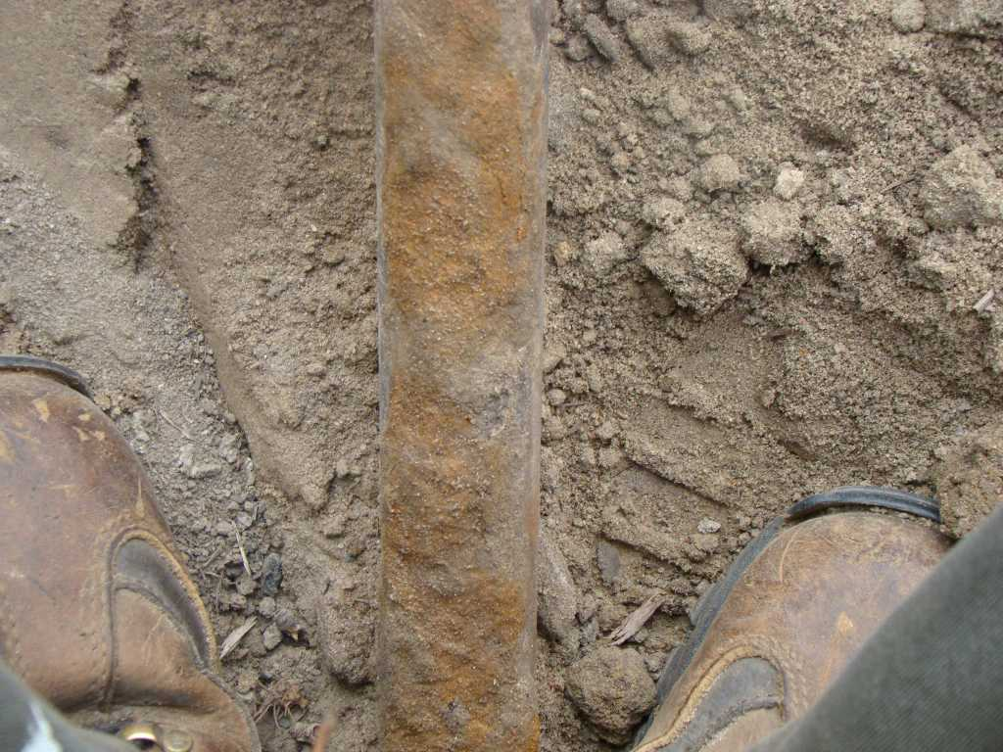
870025\870025 47.JPG

Slide 64
Testing per ASTM G71
Will determine native potentials of copper, steel, and zinc in the soil near the anchor.
Will determine mixed potential and corrosion current between copper-steel and copper-zinc when coupled in moist soil.

Slide 65
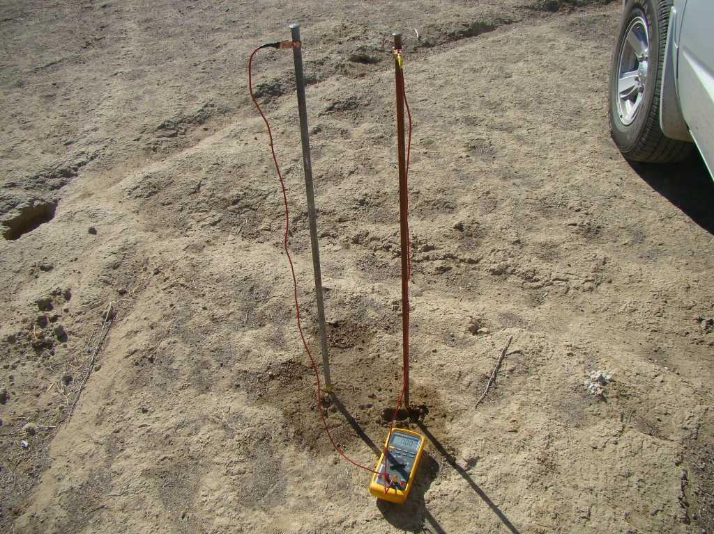

Slide 66
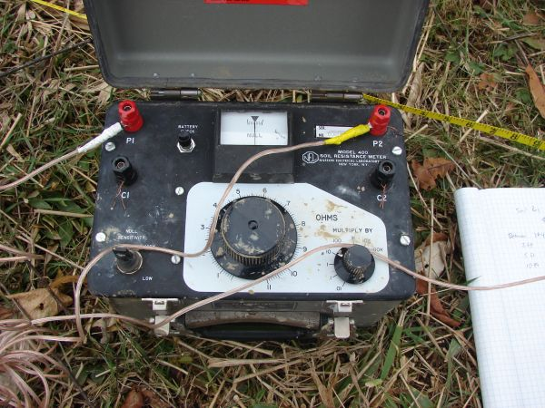
Soil Resistivity
4-pin Wenner method per ASTM G57
Pins spaced at 3ft and 12ft (spacing = a)

Slide 67
Additional Data
Dry and saturated soil resistivity in the lab
ZRA
Corrosion rate
Soil samples

Slide 68
Recommendations
Perform soil resistivity
and electrochemical potential
Determine galvanic corrosion rate
Rate the corrosion attack based on the above performance parameters
Determine electrical continuity and grounding
Design CP per NACE Standards
Establish criteria for acceptance
CP should be designed by NACE Certified Corrosion Specialist and meet NACE requirements

Slide 69
Considerations for Application of Cathodic Protection
Potentials more noble than -0.60
Corrosive soils
Age > 10 years
Soil resistivities < 5000 ohm-cm
Galvanic current > 200 to 500 micrometers
Cl > 150 ppm
Presence of stray currents, interfernce or extensive copper grounding
Water table and corrosive soil/water
Agricultural chemicals or deicing salts
Defective galvanizing
Soils with carbon and noble metal contamination
High load with no corrosion allowance

Slide 70
Summary
The corrosion evaluation protocol should be based upon corrosion engineering fundamentals and provides a base line for future inspection
The approach can be applied to all types of soil formations
When applied correctly it can reduce inspection costs extensively
It identifies high risk sites and provides guidelines and criteria for cathodic protection or other forms of corrosion control

